Slide 1

Project Management for Healthcare Professionals
Kathy Schwalbe
Sep 2015
www.healthcarepm.com

Slide 2

About Me
Ph.D., PMP, and mother of 3!
Professor Emeritus, author, and publisher
Asked to write a book focused on healthcare project management (PM) by instructors using my other books in healthcare programs
Found a great co-author (Dan Furlong) to provide healthcare focus
Got first-hand experience as well

Slide 3
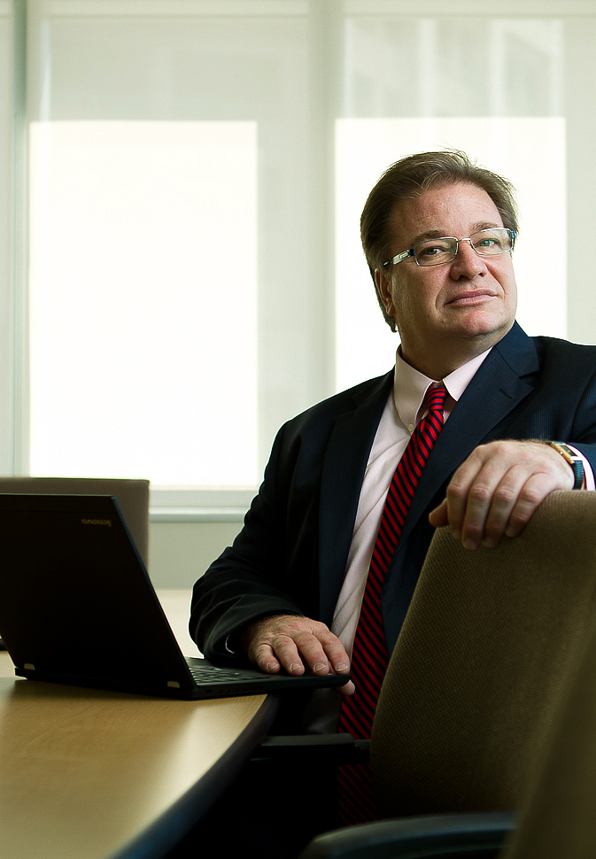
Dan Furlong
PMP, MBA, “doctor to be” (abd)
PMO for Academic Medical Center
Author
Adjunct Faculty at MUSC
Affiliated Faculty at College of Charleston
Owner of PM One, LLC
Photo courtesy of pmi.org
PM Network, Dec 2013

Slide 4
Questions About You
Do you currently work on projects related to healthcare?
Do you plan to work on projects related to healthcare?
Do you have any clinical experience?
Do you currently teach project management?
Why are you here?!

Slide 5
Session Objectives
Describe the growing need for improving healthcare project management (PM)
Discuss what’s unique about PM in the healthcare industry
Summarize recent studies on improving PM in healthcare
Show examples of best practices and what’s working
Review sample PM outputs applied to healthcare projects
Q&A and collaboration
Notes:
Recommendations
To optimize success, look for ways to limit the size, complexity and duration of individual projects, and ensure funding has been committed.
Stay on top of costs, especially for the largest projects. Ensure that there are the appropriate mechanisms in place to identify budget variances and/or overruns early. Regularly review how cost estimation is done to understand how accurate and effective your approaches are, and pursue improvement opportunities.
Keep the schedule realistic. Many large projects fail because business conditions keep changing after the project scope has been set, leaving a significant disconnect between the agreed-on scope and budget versus what the business will require and pay for by the time the project is delivered.
Invest in truly capturing and understanding the business expectations and functionality sought from the project, and ensure that there is initial, adequate allocated funding, as well as good processes in place for revisiting the expectations and required funding at multiple points during the project.
Increase the frequency of project status and review meetings, as well as ongoing confirmation of the project’s alignment with business strategy — with an eye toward identifying and cancelling projects at the earliest possible stage that no longer meet company needs.

Slide 6
The Need
“Thanks in large part to the expansion of coverage under Obamacare, health care spending in the U.S. is projected to have hit $3.1 trillion, or $9,695 per person, last year. That's an increase of 5.5%, according to federal estimates released Tuesday. It's the first time the rate would exceed 5% since 2007.”*
Compared to other Organisation for Economic Co-operation and Development countries, the U.S. spends 48% more on healthcare compared to the next highest country, Switzerland**
* Tami Luhby, “Health care spending expected to grow faster” CNN Money (July 28, 2015).
**The Henry J. Kaiser Family Foundation. Healthcare Costs: A Primer, Key
Information on Healthcare Costs and Their Impact (2012).

Slide 7
Healthcare Project Drivers
American Recovery & Reinvestment Act (2009)
  Included the Health Information Technology for Economic & Clinical Health (HITECH) Act
  Increased HIPAA rules, enforcement, fines
  Creates incentives / penalties for meaningful use of EMRs
Patient Protection and Affordable Care Act (2010)
  Accountable Care Organizations (ACO)
  Disproportionate share payments gone
  Forces improvements in efficiencies
These acts, coupled with movements to patient-centered care, evidence-based medicine, centers of excellence, and other forces have spawned a current climate of what may be an unsurpassed number of healthcare projects

Slide 8
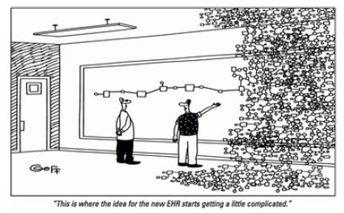
“Complex? Oh, this is just where the nurses get engaged in the project!”

Slide 9
What’s Different About Healthcare PM?
There are two “camps” of staff:
  clinical (patient focused)
  enterprise viability and sustainability (business focused)
Healthcare has unique terms / processes
Projects often have separate paths that can be divided into phases – technical and clinical
Project management is not as mature / practiced in healthcare; little training, PMs not respected?
Decision-making can be very slow…

Slide 10
Stuck on the Elevator?
Show video
Good TEDx talk on the future of medicine (What healthcare will look like in 2020, Stephen Klasko TEDxPhiladelphia, Nov. 17 2014) – “We got tired of whining”
  Train doctors and other medical professionals differently (focus on EI and teamwork, not scores on multiple-choice tests and organic chemistry grades)
  Make better use of technology (apps for that)
  Promote entrepreneurship (focus on patient care, ratings, etc.)

Slide 11
Clinicians View
Project “Success” Differently
Scope
Typical
Perspective
Efficient
Clinical Workflows
Clinical
Perspective
Time
Cost
Patient Safety
Outcomes

Slide 12
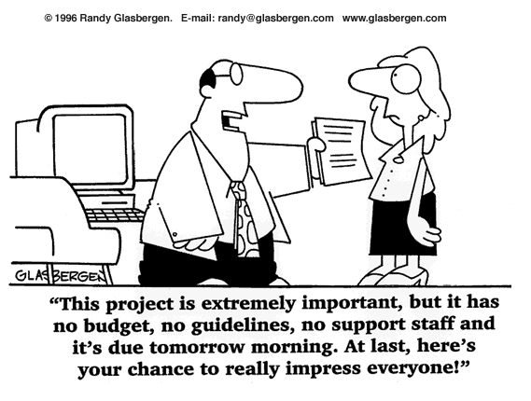

How do we get past this?
“How am I supposed to find the time to fill out all these requirement documents?
I am here to treat patients, not do paperwork!”
40

Slide 13
Education Can Help
Public health and healthcare leaders need to:
  Work on the right projects
  Educate PM staff on clinical work & clinical staff on PM; get them to work together
  Make investments in IT, infrastructure, and quality improvements that will allow them to reduce costs while improving (or maintaining) quality…
Good project management is required!
Showing clinical leaders PM value is a must!

Slide 14
Findings from 2012 Study*
Healthcare workers do not understand the differences between service work and project work. They understand activities to provide better service to patients, but they have not been trained to make more radical, disruptive changes that challenge the status quo.
Healthcare projects are done to create something that is delivered to the organization, unlike operational work which produces outcomes aimed at patients. “In other words, it is only once the project’s outcome is implemented and becomes ‘the new way we work now’ that it starts exerting its impact on patients.”
*Francois Chiocchio et al, “Stress and Performance in Health Care Project Teams,” Project Management Journal® (2012).

Slide 15
Suggestions from that Study
Train healthcare workers on PM, emphasizing collaborating on achieving project goals and understanding their roles on project teams, which may differ from their roles in their day-to-day work
Management needs to structure project teams by properly planning workers’ time and payment to allow them to successfully engage in project work

Slide 16
New Findings from 2015 Study*
First study to focus on on-the-job training of healthcare professionals’ PM capability when involved in collaborative project work
Three half-day training workshops were designed and delivered to 14 interprofessional healthcare project teams and measures taken over 36 weeks
Results: Training fostered high satisfaction and perception of utility, self-efficacy for task work and teamwork, increased goal clarity and implicit coordination, and better performance of projects!
*Francois Chiocchio et al, “Multi-Level Efficacy Evidence of a Combined Interprofessional Collaboration and Project Management Training Program for Healthcare Professionals,” Project Management Journal® (2015).

Slide 17
Suggestions for Applying Good PM in Healthcare
Provide motivation to organizations and individuals
Focus on key concepts
Provide real-world examples with references of what went right, what went wrong, best practices, etc.
Explain how to apply concepts with samples - like our running case on Ventilator Associated Pneumonia Reduction (VAPR)

Slide 18
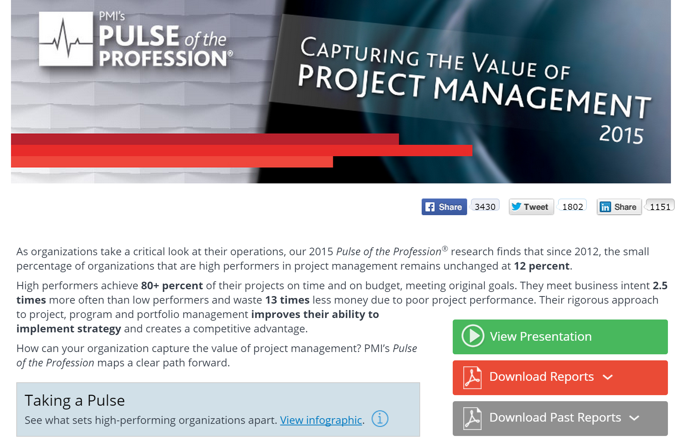
Organizational Motivation

Slide 19
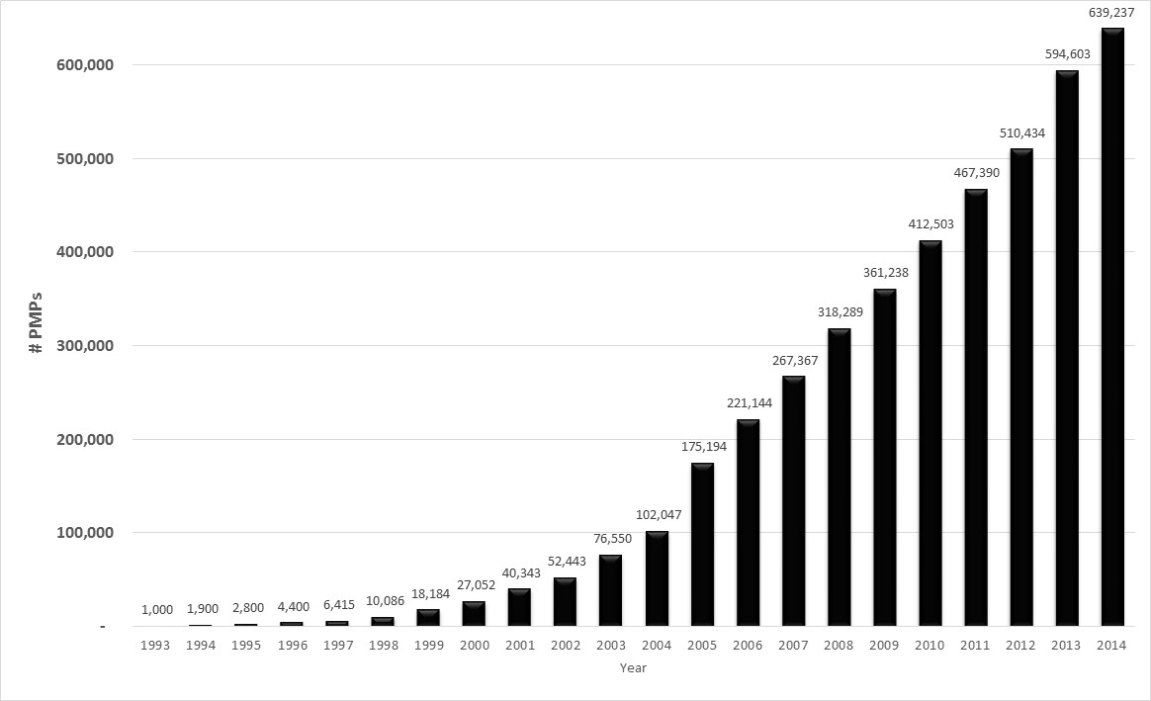
Individual Motivation:
PMP Certification and Jobs
Healthcare is one of the 6 sectors to watch for growth in PM jobs*
*Kate Sykes, “Global Jobs Report: 6 Sectors to Watch,” PM Network (January 2014).

Slide 20
Samples of Best Practices
2010 PMI Project of the Year Finalist: Norton Brownsboro Hospital Project
Virginia Mason Medical Center (use workflow managers to eliminate waste – get rid of waiting rooms?)
Mayo article on accelerating the use of best practices
Articles on healthcare.gov (Obama’s Trauma Team)
Agile in healthcare
Other examples

Slide 21
Sample PM Outputs
  Pre-Initiating and Initiating: SWOT analysis, mind map, balanced scorecard, business
  Planning: project management plan, scope statement, requirements traceability matrix, WBS, project schedule, cost baseline, quality metrics, human resource plan, project dashboard, probability/impact matrix, risk register, supplier evaluation matrix, stakeholder management plan
  Executing: deliverables, milestone report, change requests, project communications, issue logs
  Monitoring and controlling: earned value chart, accepted deliverables, quality control charts, performance reports
  Closing: project completion form, final report, transition plan, lessons-learned report, contract closure notice

Slide 22
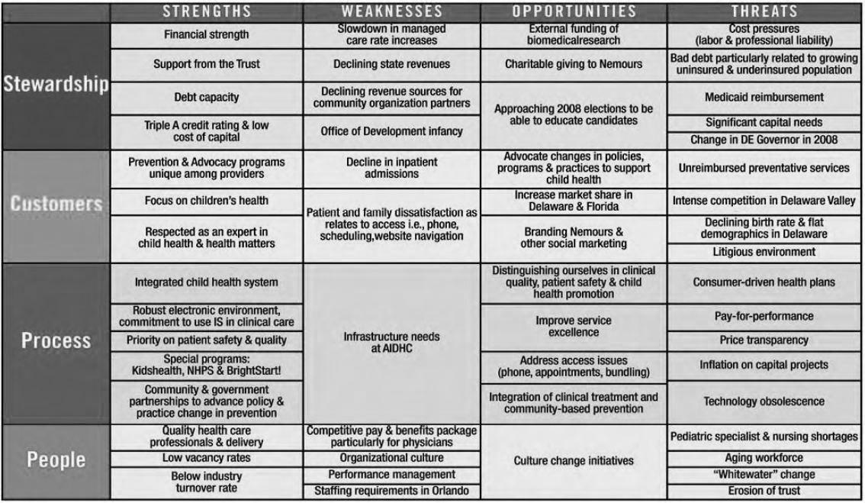
SWOT Analysis
*¹Nemours, “Blueprint for the Future: Nemours Strategic Plan 2008-2012,” Nemours, (2007).

Slide 23
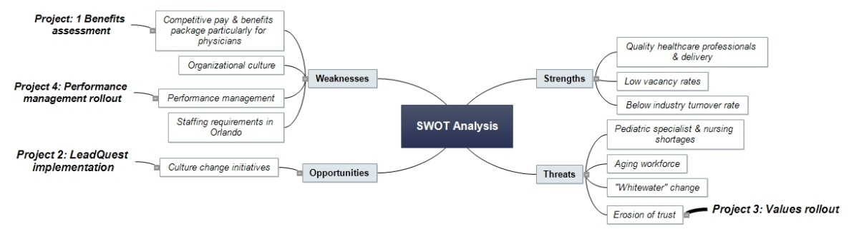
Mind Map to Help Identify Projects

Slide 24
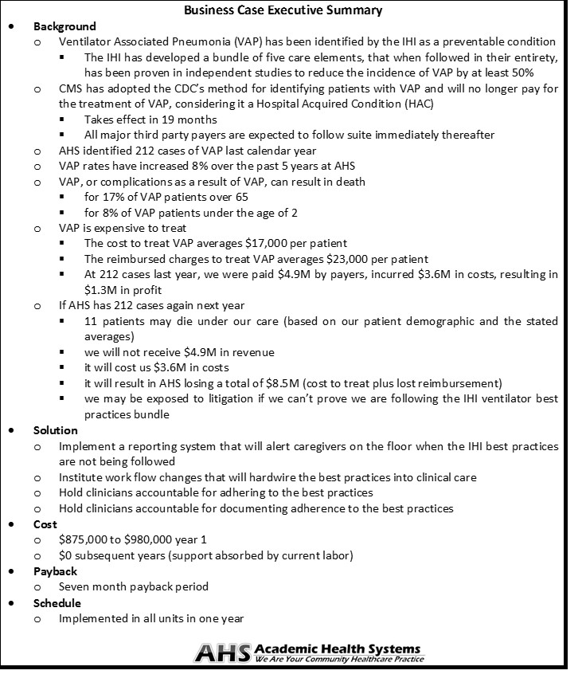
Business
Case for
VAPR Project
Copyright 2013 Schwalbe Publishing

Slide 25
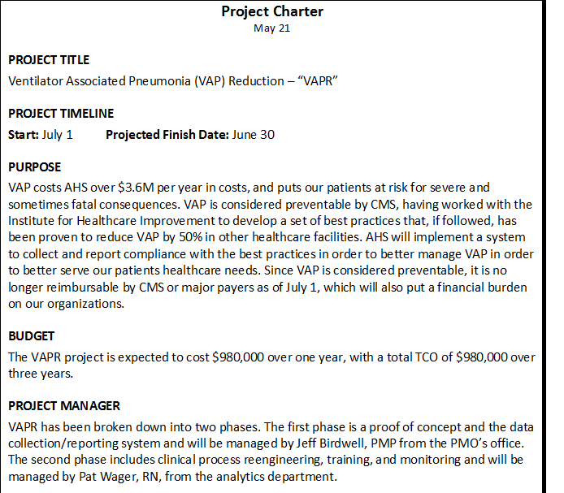
Project
Charter
Copyright 2013 Schwalbe Publishing

Slide 26
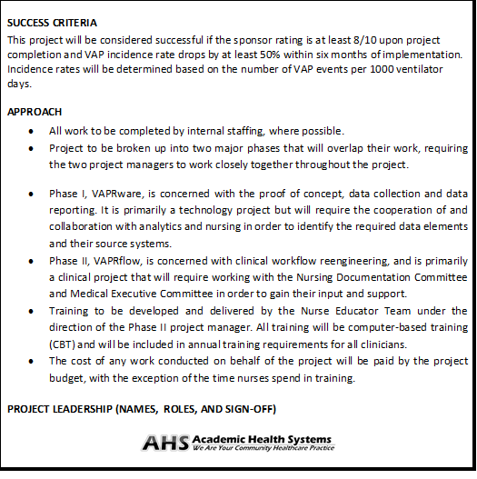
Project
Charter
(cont’d.)
Copyright 2013 Schwalbe Publishing

Slide 27
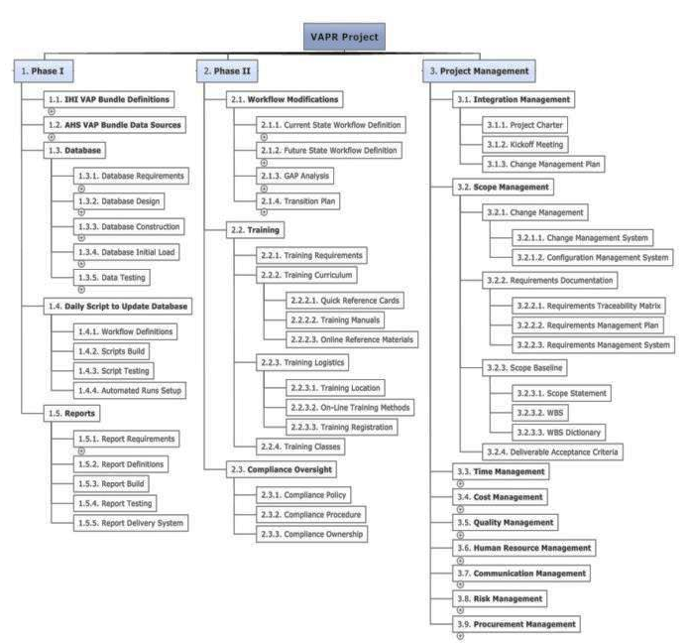
WBS
Copyright 2013 Schwalbe Publishing

Slide 28
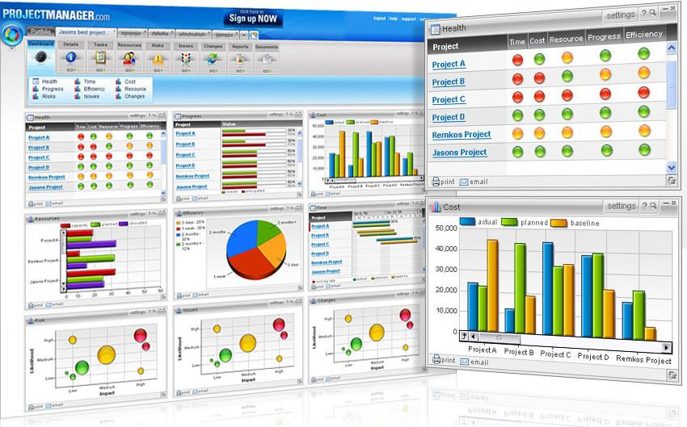
Project Dashboard
Metric | Description | Status | How Measured | Explanation
Scope | Meeting project goals | ● | Earned value chart | On target
Time | Staying on schedule | ● | Earned value chart | Slightly behind schedule
Cost | Staying on budget | ● | Earned value chart | Under budget
VAP Bundle | Identify AHS systems with required elements | ● | Percent of elements identified in AHS systems | All elements identified and available
VAP reduction | Reduce by 50% within six months | ↔ | Infection Control data | Cannot collect until after implementation
Percent of ICU staff trained | Train all ICU staff prior to go live | ● | Training Management System test results | Learning management system down for four days causing a delay in training. We expect to catch up quickly.
Track
Metrics
● On Target | ● Off Target / problem area
● Slightly off target / caution area | ↔ Not able to collect data yet
Copyright 2013 Schwalbe Publishing

Slide 29

Cause and Effect Diagram
Find
Root Cause
Copyright 2013 Schwalbe Publishing

Slide 30
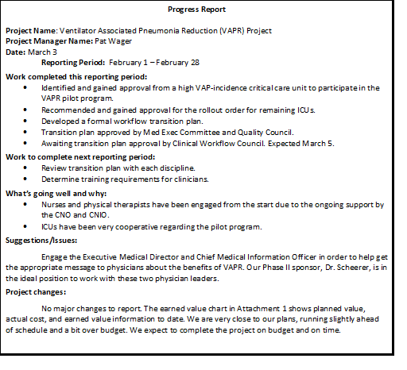
Progress Report
Copyright 2013 Schwalbe Publishing

Slide 31

Challenges in Applying Good PM in Healthcare?
Audience inputs:

Slide 32
Resources
FREE companion Web site for Healthcare Project Management includes
  Over 60 template files
  Links to great videos
  Interactive quizzes, cases, articles, etc.
Secure instructor site (lecture slides, sample syllabi, test banks, etc.) and desk/review copies also available
www.healthcarepm.com

Slide 33
Conclusions
The healthcare industry is behind most other industries in terms of project, program, and portfolio management
There’s a huge need to educate clinical staff in managing the many healthcare-related projects
We can improve healthcare in this country – one person, one talk, one course, and one project at a time!

Slide 34
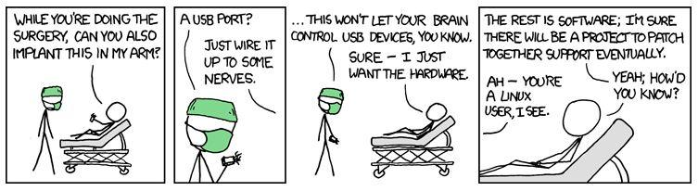
Too bad we can’t implant software to make us all smarter – yet!
Source: xkcd.com

Slide 35
Or Can We? Cyberise.me!*
“Smith likes to hack his own body. He has a total of four RFID chips he injected into himself with a disturbingly large needle. He uses them for various purposes, including one for storing cloned smart cards and another for unlocking his Android phone. He also has a magnet inserted into his finger, extending his senses to feel magnetic fields.”
*Thomas Fox-Brester, This Man Implanted A Chip In His Arm To Hack His Way Into Buildings by Thomas Fox-Brester, Forbes (August 5, 2015).

Slide 36
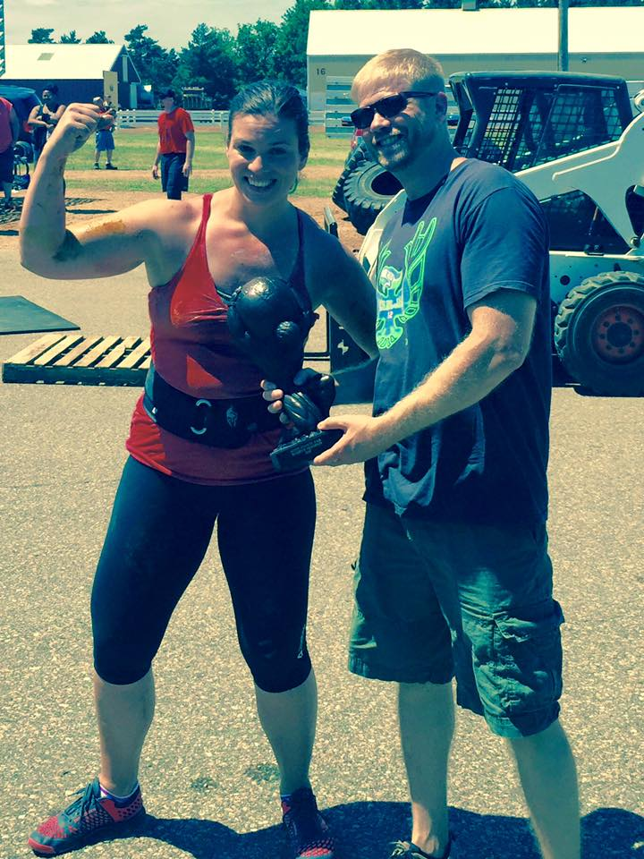

Questions?
Our daughter – strong woman!
My new hobby – windsurfing!
www.healthcarepm.com
schwalbe@augsburg.edu

