Slide 1
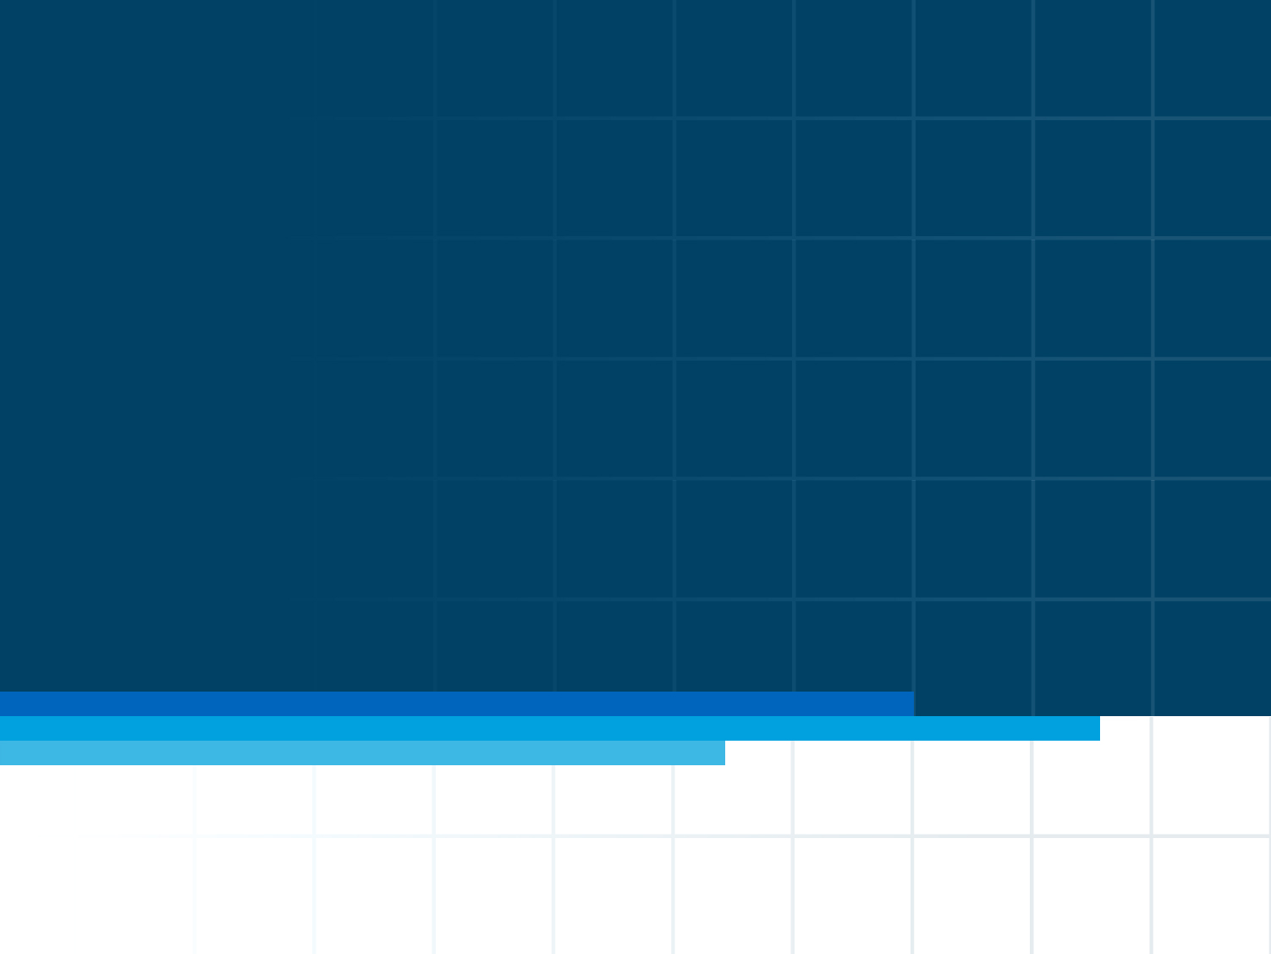
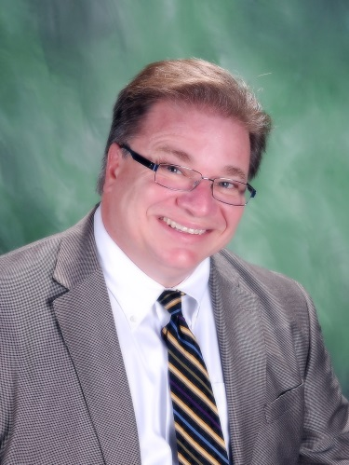


HEALTHCARE
Community of Practice Presents
Healthcare Project Management
Dan Furlong & Kathy Schwalbe
13 Dec 2013
Notes:
This presentation is intended for the starting segment: project management practitioners who don’t know much about PMI, and/or beginners, students, and others considering a career or specialization in project management. PMI members already know (or should know!) most of what’s in it. It provides a basic look at what PMI is, what it does, and why membership and PMI credentials are smart moves for practitioners. It should take about 20 minutes at a conversational pace.
Component leaders who are addressing organizations – businesses, government bodies, or non-profits -- should use “The Value of Project Management,” which concentrates on organizational rather than personal benefits.
Obviously every audience is different, and there’s a lot of information that won’t fit into the slides and speaker notes. Learn as much as you can about the audience in advance and use your judgment: feel free to delete a slide, skip past it quickly – or to expand on the speaker notes if there’s a topic of special interest to this group.
Some slides have action buttons in the top right corner. If you’re online during the presentation, and want to dig a little deeper, those buttons will open the relevant page at the PMI website. The corresponding URLs are found in the speaker notes (and are also live links when you’re using PowerPoint’s “notes page” view).
LAST UPDATED February 2009

Slide 2
Important Webinar information
VOIP technology will be utilized, no conference line is available, all questions should be entered into the Chat window
Join us for continuing discussion after the Webinar on the blog created for this Webinar at
Visit our web site and access the blog from the Community tab, choose Blogs

Slide 3
Give Back to the Profession as our Presenter and volunteer support team are today:
Earn PDUs for sharing your experience managing Healthcare projects with other members of the Healthcare CoP.
  Contact us at Healthcare.edu@vcleader.pmi.org to get more details
Earn PDUS for volunteering with the Community of Practice
  Contact us at healthcare.member@vcleader.pmi.org for more details

Slide 4
Reporting PDUs
We will record a PDU for all attendees at today’s LIVE presentation. If you do not see the acknowledgement of the award of the PDU within 48 hours, please contact us at Healthcare.edu@vcleader.pmi.org
For those viewing the recording post Live Webinar, the PDU can be entered using 20131213, Provider S040
HIMSS continuing education
    CPHIMS Credential
    CAHIMS Credential

Slide 5
Important information
Today’s presentation is being recorded and will be available for you on the Healthcare CoP website . After logging on to the home page , choose Webinars from the tool bar at the top of the page. Choose Recorded Webinars and choose this or any previously conducted Webinar for viewing
Our website can provide you with information about upcoming events. Feel free to read or start a blog under the Community tab on the tool bar at the top of the page.
Please visit often!!!!

Slide 6

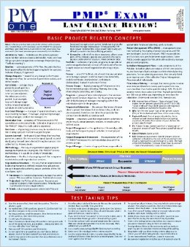







Conflict of Interest Disclosure
Dan Furlong, PMP, MBA, CPHIMS, FHIMSS
PMI Leadership Institute Masters Class, Class of 2008
Has no real or apparent
conflicts of interest to report.
I am affiliated with the following organizations / endeavors as an employee,
faculty member, board member (past/present), author, or owner.

Slide 7

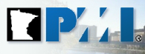
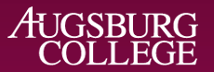

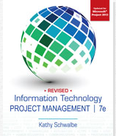
Conflict of Interest Disclosure
Kathy Schwalbe, Ph.D., PMP
Has no real or apparent
conflicts of interest to report.
I am affiliated with the following organizations / endeavors as an employee,
faculty member, board member, author, or owner.

Slide 8
Today’s Objectives
Learn why healthcare project management is growing
Understand the unique challenges of managing healthcare projects
Discuss real techniques that can be used to improve stakeholder participation & project success
Learn how to grow your knowledge

Slide 9
Questions About You
Do you currently work on projects in the healthcare industry? (yes/no)
Are projects selected and managed well in your organization? (yes/no)
What is your biggest challenge?
  Not understanding clinical workflow or terminology
  Lack of clinical stakeholder engagement
  Lack of organized PM structure/methodology in use
  Difficulty introducing change into clinical workflows
  None of the above – we have other problems
Would you like to see examples of project management tools applied to a clinical healthcare project? (yes/no)

Slide 10
What’s Going on in Healthcare?
HITECH Act
  Health Information Technology for Economic and Clinical Health Act
  Part of the American Recovery and Reinvestment Act of 2009 (Title XIII)
  Invested over $30B in healthcare technology
  Stiffened HIPAA requirements / penalties
Patient Protection and Affordable Care Act (ACA/ObamaCare)
  Forcing healthcare providers, insurers, and DME manufacturers to be more transparent and cost effective
Other marketplace forces
  Movements to patient-centered care, increased competition, evidence-based medicine, centers of excellence, etc.
  Together they have Created an Unsurpassed Need for Change!

Slide 11
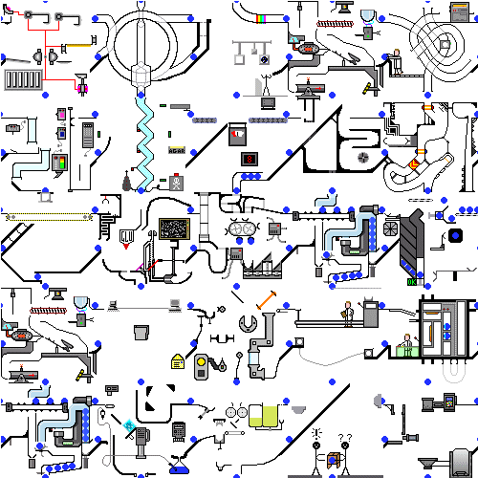
Healthcare is Becoming Even More Complex!

Slide 12
We View Project “Success” Differently
Scope
Old
School
Project
Manager
Perspective
Efficient
Clinical Workflows
Clinical
Perspective
Time
Cost
Patient Safety
Outcomes

Slide 13
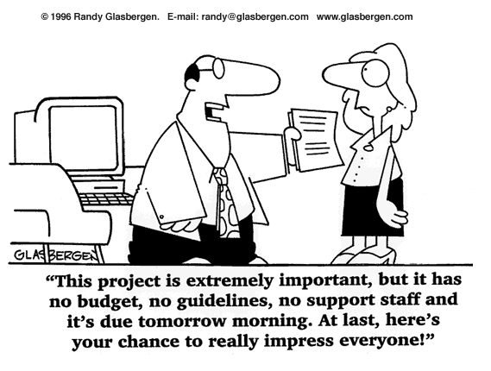

Sound Familiar?
“How am I supposed to find the time to fill out all these requirement documents?
I am here to treat patients, not do paperwork!”
40

Slide 14
Unique Challenges – Stakeholders
The subject matter experts have more critical duties to fulfill
Physicians
  Are considered part artist, part scientist
  Are not scheduled time to work on projects
  Lose significant money for any time spent on projects
  Typically have work that can’t be handed off to others
  Are specialized
Nurses
  Are already understaffed
  Are already picking up all duties left undone by others
  Do not have backup staff to cover them
  Are often specialized
Along with a host of pharmacists, therapists, surgeons, etc.

Slide 15
Unique Challenges - Environment
There is little room for failure
  Small problems can quickly become large
  Uncontrolled changes can cause injury or death
Trump card: “First Do No Harm”
Until recently
  Time was not of the essence
  Cost was not a limiting factor
HITECH & ACA have changed all that
  Compliance deadlines
  Higher security requirements
  Transparency of outcomes
  Reduced reimbursements forcing efficiencies
Few healthcare organizations have formal PM structures

Slide 16
Unique Challenges - Collaboration
There are multiple command hierarchies
  Physician
  Nursing
  Therapies
  Administration
  Academic (if academic medical center)
  Practice plan
Clinical roles define authority levels
There is very clear “pecking order”
The perceived pecking order sometimes gets in the way of open collaboration and cooperation
There is a recent drive toward inter-disciplinary cooperation

Slide 17
!
Remember!
Projects are about solving business problems!

Slide 18
!
…and our business is patient care!
So how do we make this work?

Slide 19
?
And what is it that project managers do?

Slide 20
❒
We Manage Change!
We “Lead the Way”!
Bill Stewart
PMLG
We “Create the Future”!
Dr. John Adams
PMI Fellow

Slide 21
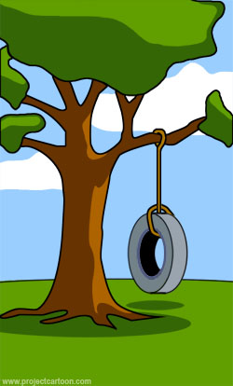




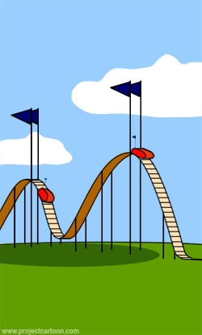
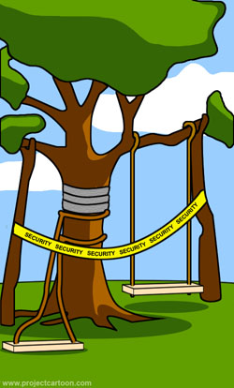
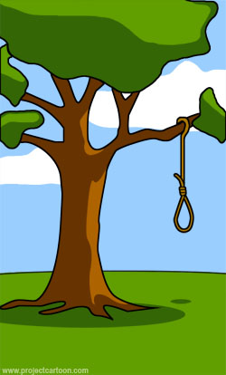
Be careful about making deals with the devil…
IT’s First Attempted Solution
IT’s Attempt at Improvement
Paper Based “System”
IT’s Second Solution
Customer’s Perception of All IT Attempts
What Users Really Wanted
How Users Feel About Project Managers
IT’s Final Solution

Slide 22
?
So How Can We Improve on HC Project Outcomes?

Slide 23
!
1st & Foremost!
IT is an Enabler!
These are not IT Projects!

Slide 24
What Can You Do? – Adapt!
Learn clinical terminology
  Study/read all you can
  Spend time on the floor
  No matter what you know, remember they are the experts
Be willing to accept less than 100% commitment from clinical staff
  Plan for & learn to work around it
  Plan for & learn to use pieces/parts of different staff
Incentivize staff to participate
  Gift cards, candy, coffee
  Training opportunities, new skills
Work to their schedules
  Early / late meetings
  On-the-floor updates

Slide 25
What Can You Do? – Mentor!
Consider having clinicians lead projects
  They are brilliant, but be sure they have the aptitude for PM
  If not PM trained or experienced in PM
    Mentor, mentor, mentor
    Set the expectation up front so there are no surprises
    Be flexible, but do not allow corners to be cut
    Give them the tools they need
    Offer to facilitate meetings where stakeholders in higher roles will be participating
  Stay neutral
  Provide honest feedback
  Learn from them
Remember you are all on the same team

Slide 26
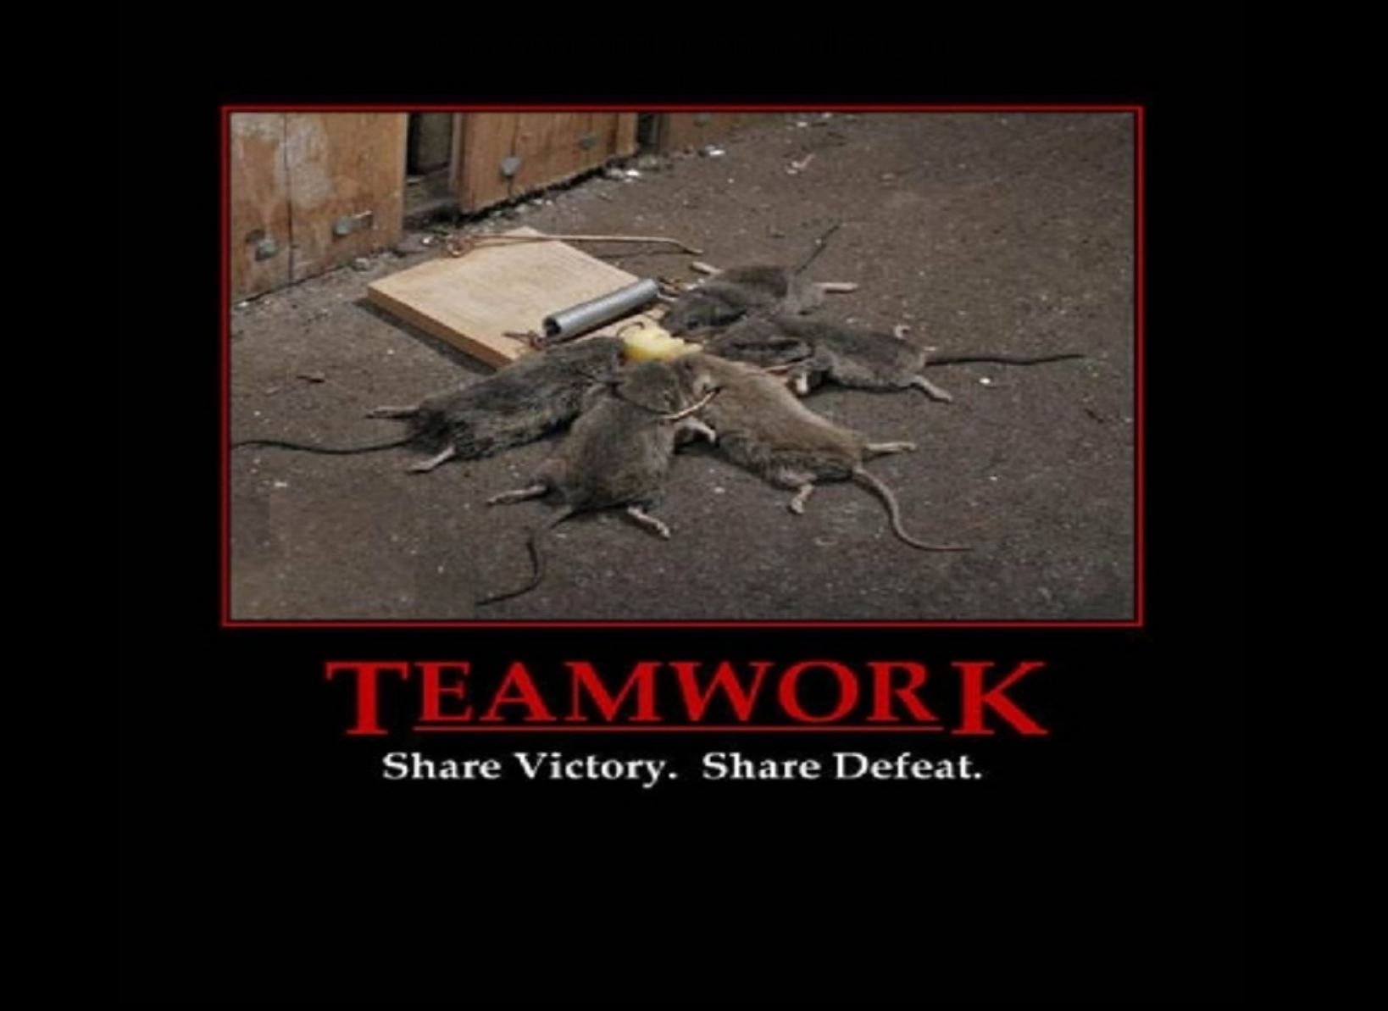
What Can You Do? – Mentor!
Consider having clinicians lead projects
  They are brilliant, but be sure they have the aptitude for PM
  If not PM trained or experienced in PM
    Mentor, mentor, mentor
    Set the expectation up front so there are no surprises
    Be flexible, but do not allow corners to be cut
    Give them the tools they need
    Offer to facilitate meetings where stakeholders in higher roles will be participating
  Stay neutral
  Provide honest feedback
  Learn from them
Remember you are all on the same team

Slide 27


IT Staff
Last of all, always try to identify & recruit clinician champions!
Clinical Champions
Clinical Staff

Slide 28
What Can You Do? – Be the Guru!
Above all, build relationships
Know what you don’t know
  Defer to the experts in the room for clinical expertise
  They will defer to you for PM expertise
Be cognizant of roles and hierarchies, but instill a project environment of respect
Be a strong facilitator
  Prepared
  Organized
  In control of meetings
Consider budgeting for staff time
Kick off meetings with PM training
Have a methodology / process for every meeting
Consider installing in pieces/parts (modules) to improve acceptance
Use tools, props, and anything else that works

Slide 29
Some Academic Info: Good Project Management Can Help Reduce Stress!
Healthcare workers do not understand the differences between service work and project work. They understand activities to provide better service to patients, but they have not been trained to make more radical, disruptive changes that challenge the status quo. “… it is only once the project’s outcome is implemented and becomes ‘the new way we work now’ that it starts exerting its impact on patients.”
Need to train healthcare workers on PM, emphasizing collaborating on achieving project goals and understanding their roles on project teams, which may differ from their roles in their day-to-day work.
Management needs to structure project teams by properly planning workers’ time and payment to allow them to successfully engage in project work.
*Francois Chiocchio et al, “Stress and Performance in Health Care Project Teams,” Project Management Institute (2012).
Notes:
DAN: Changed font to match other slides. Changed title to be consistent with rest of PPT. A very good slide – good to have published work to support our points.

Slide 30

A Good Reference & Approach
Start chapters with realistic opening cases
Provide real-world examples with references of what went right, what went wrong, best practices, media snapshots, healthcare perspectives, and video highlights
Explain key concepts and then apply them with samples from a running case on Ventilator Associated Pneumonia Reduction (VAPR)
End with a closing case and lots of end-of-chapter materials
Extra info on free Web site (healthcarepm.com)

Slide 31
Sample Outputs in HC PM Book
  Initiating: business case, stakeholder analysis, charter
  Planning: project management plan, scope statement, requirements traceability matrix, WBS, project schedule, cost baseline, quality metrics, human resource plan, project dashboard, probability/impact matrix, risk register, supplier evaluation matrix, stakeholder management plan
  Executing: deliverables, milestone report, change requests, project communications, issue logs
  Monitoring and controlling: earned value chart, accepted deliverables, quality control charts, performance reports
  Closing: project completion form, final report, transition plan, lessons-learned report, contract closure notice

Slide 32
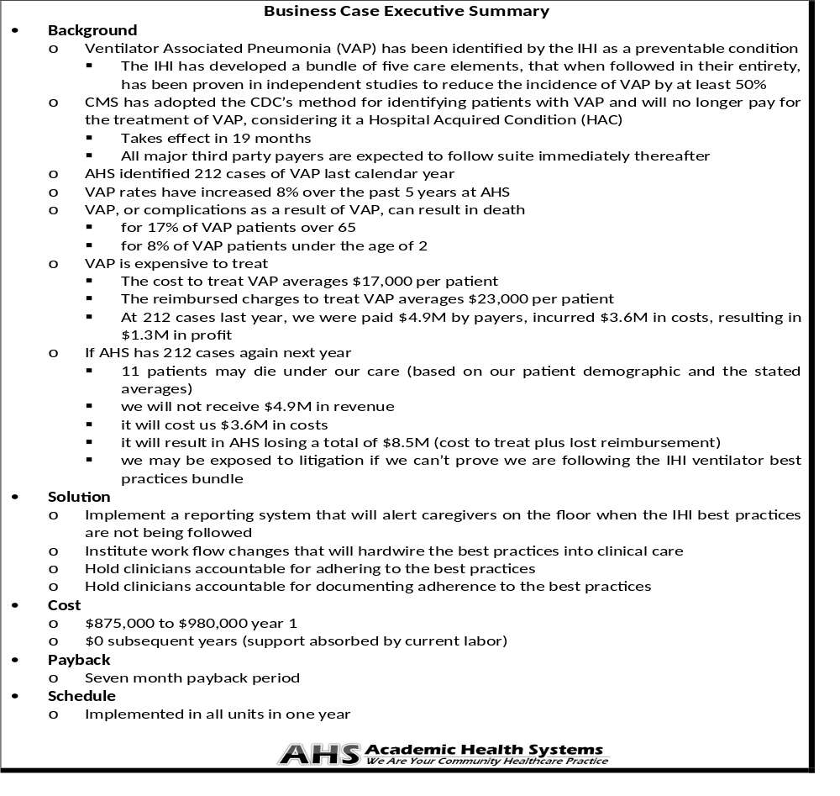
Business Case
(partial)
Copyright 2013
Schwalbe Publishing

Slide 33
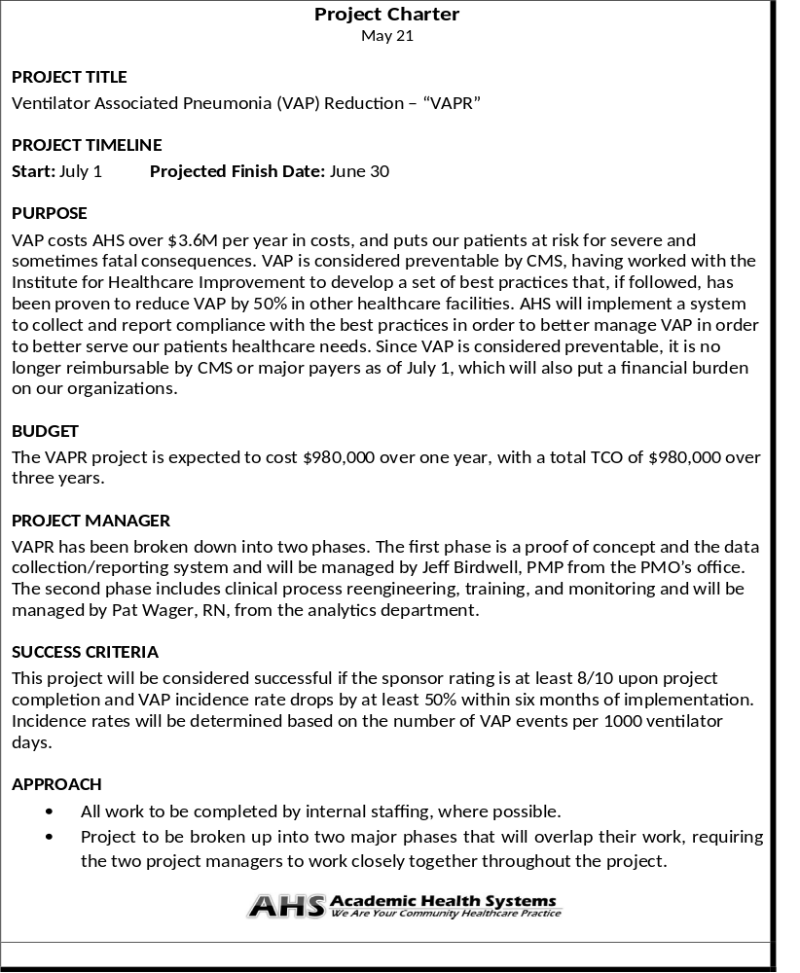
Project
Charter
(partial)
Page 2
Page 1
Copyright 2013
Schwalbe Publishing

Slide 34
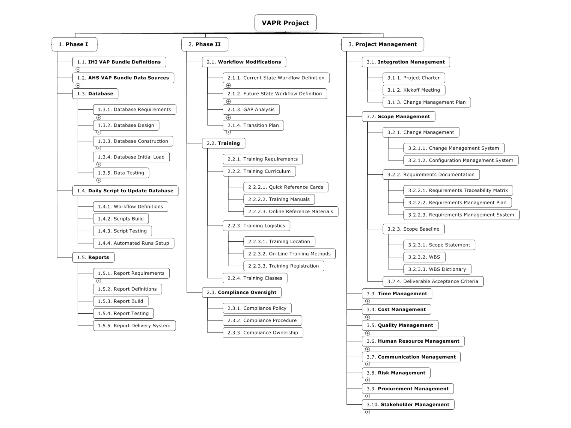
WBS
Project scope / deliverables
Copyright 2013
Schwalbe Publishing

Slide 35
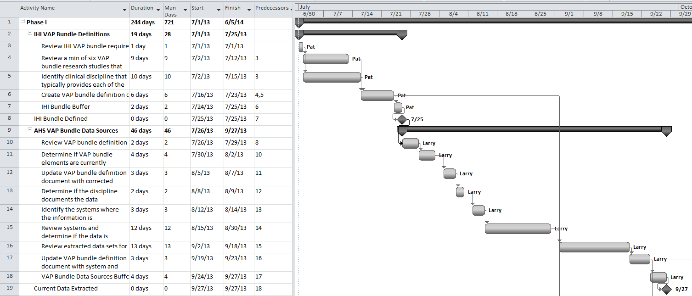
Gantt chart / Project schedule
Copyright 2013
Schwalbe Publishing

Slide 36
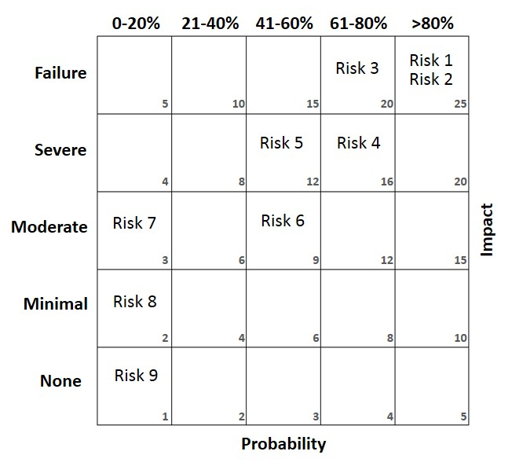
Probability Impact Matrix
Must identify & prioritize risks before you can manage them
Copyright 2013
Schwalbe Publishing

Slide 37
Project Dashboard
Metric | Description | Status | How Measured | Explanation
Scope | Meeting project goals | ● | Earned value chart | On target
Time | Staying on schedule | ● | Earned value chart | Slightly behind schedule
Cost | Staying on budget | ● | Earned value chart | Under budget
VAP Bundle | Identify AHS systems with required elements | ● | Percent of elements identified in AHS systems | All elements identified and available
VAP reduction | Reduce by 50% within six months | ↔ | Infection Control data | Cannot collect until after implementation
Percent of ICU staff trained | Train all ICU staff prior to go live | ● | Training Management System test results | Learning management system down for four days causing a delay in training. We expect to catch up quickly.
Track
metrics
● On Target | ● Off Target / problem area
● Slightly off target / caution area | ↔ Not able to collect data yet
Copyright 2013
Schwalbe Publishing

Slide 38

Cause & Effect Diagram
Red highlighted boxes indicate the causes determined to be at the root of the problem, but only after all potential causes were investigated and others ruled out.
Checkbox is on an obscure screen
Nurses busy and must prioritize work
Find root
cause
Copyright 2013
Schwalbe Publishing
Notes:
Kathy, I would like to talk about this slide. I want to highlight how Database, Equipment, and Interfaces could not have been the problem so it had to be around the Nursing Workflow. However, we check the potential causes anyway. The real problem was two fold. 1) the checkbox was on a window/screen that took work to get to, and the nurses did do it at shift change because they do a full documentation pass during shift change. However, during the middle of shifts (hourly), they did not see the importance of documenting HOB because they were too busy finishing their patient rounds. So it was two fold : Hard to get to the box, and they were busy. We moved all ventilator fields to one screen and although the nurses are still busy, they no longer have to prioritize because it is all in front of them. Technically you could argue that the checkbox location was the real problem, but even if not obscure, the nurses being busy and not wanting to switch screens would have still been a problem. Interesting part was that the CHECKBOX cause was never discovered initially. It was brought up while talking to nurses about how being busy impacts the checkbox not being completed properly. ☺

Slide 39
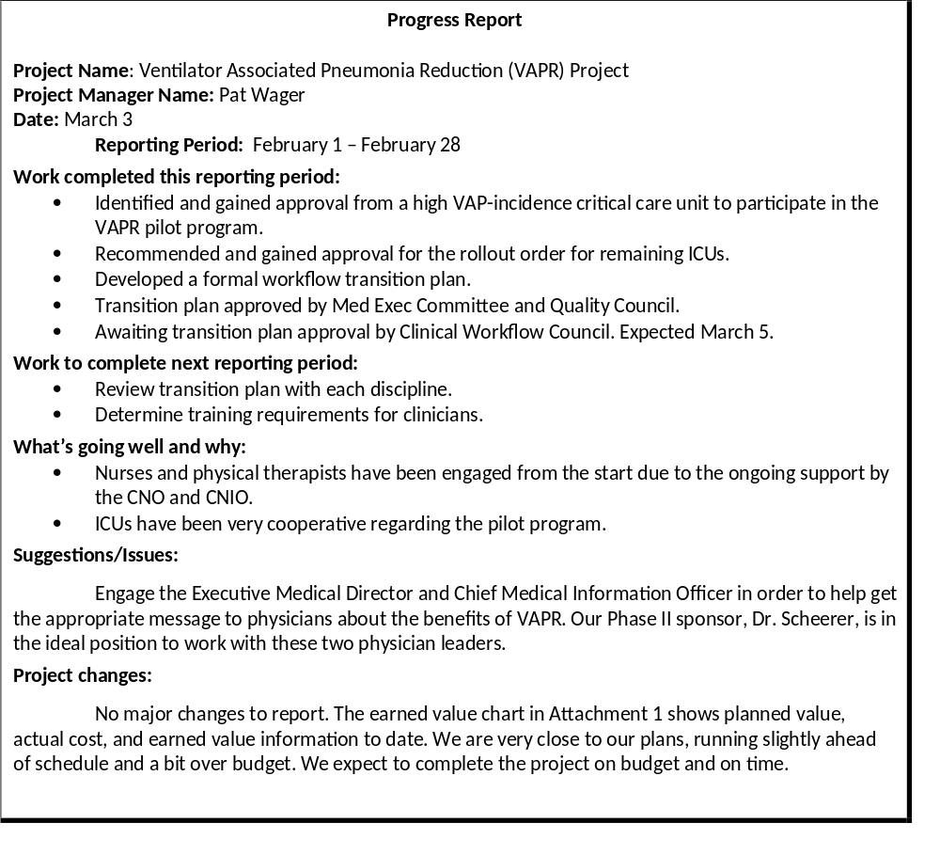
Progress (Status) Report
Super tool everyone should use!
Copyright 2013
Schwalbe Publishing

Slide 40
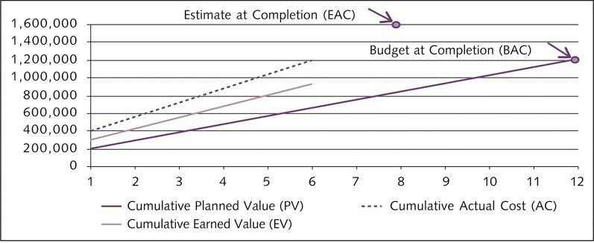
Earned Value Tracking
Assess progress in meeting scope, time, and cost goals
Copyright 2013
Schwalbe Publishing

Slide 41
Best Practice – Earned Value Management
The Centers for Medicare & Medicaid Services (CMS) manages approximately twenty percent of the entire Federal budget, so it is important that they use the taxpayers' dollars as efficiently and effectively as possible.
“Once an investment—with its individual projects—is approved for funding, it falls to the investment manager and the project managers to insure that the projects are implemented successfully. Earned value monitoring and management provides early warning when a project is straying from its baseline plan, and shows whether actions taken to correct the situation are effective. Health and Human Services (HHS) requires that certain investments track and report on cost and schedule status monthly.”*
*CMS Centers for Medicare & Medicaid Services, Division of Information Technology Investment Management Enterprise Architecture & Strategy Group Office of Information Services, “Earned Value Management Best Practices” (Nov 19, 2009).
Copyright 2013
Schwalbe Publishing

Slide 42
!
A Few Tools in Action!
Easy to Bring Examples to Practice!

Slide 43
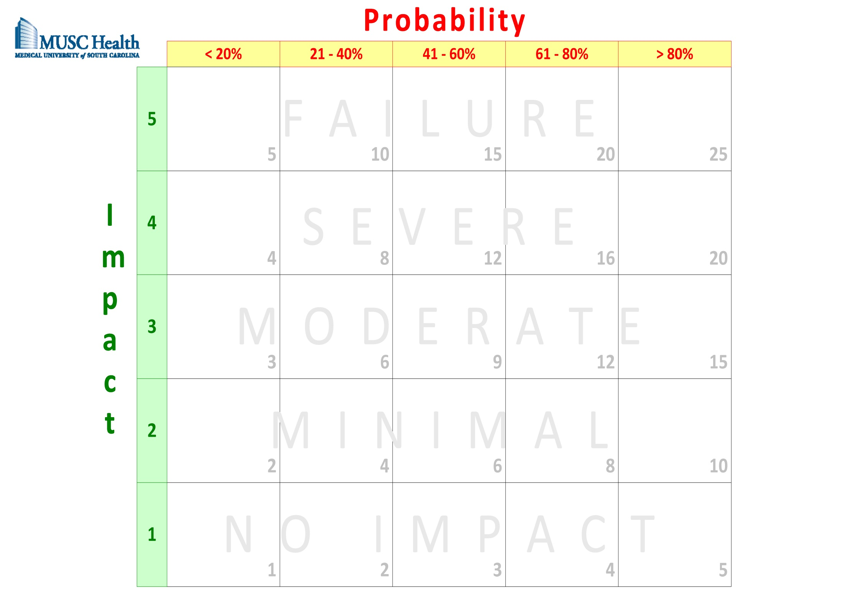
Risk Matrix

Slide 44
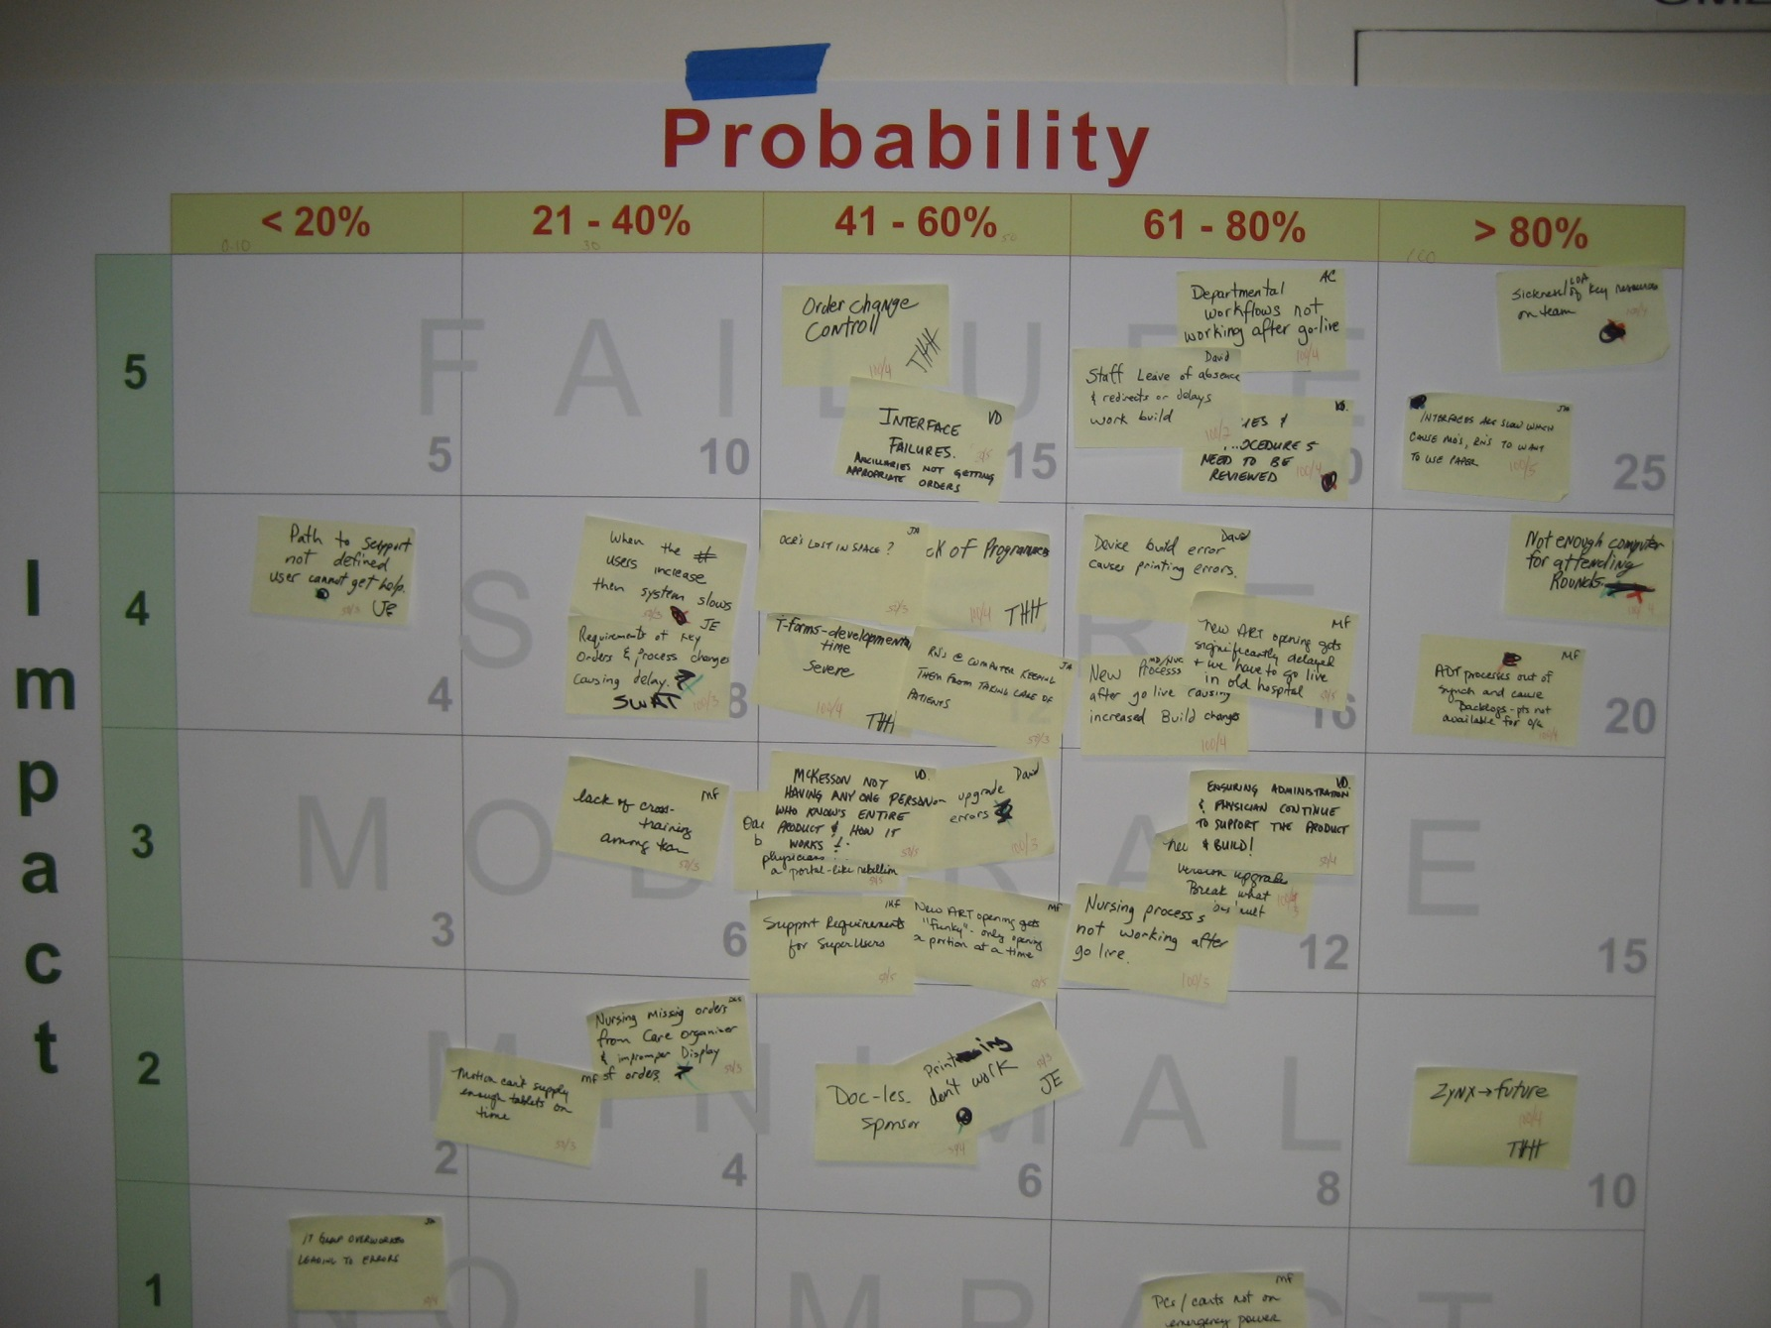
Risk Matrix
20
25
16
20

Slide 45
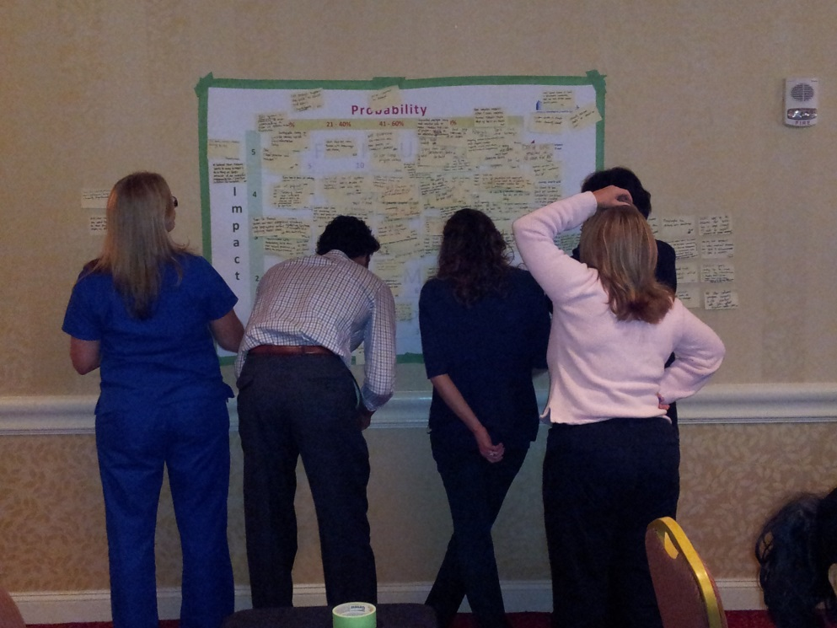
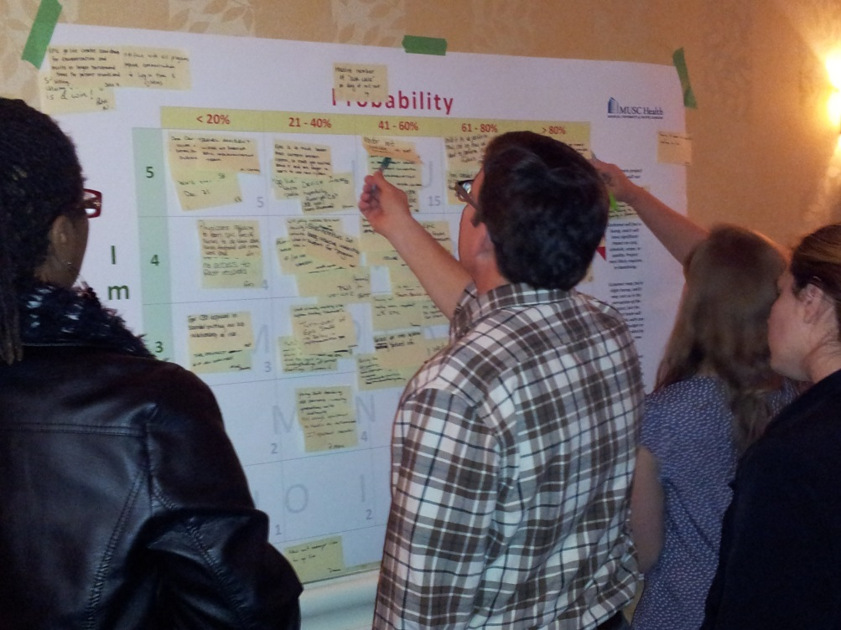
Risk Matrix
20
25
16
20

Slide 46
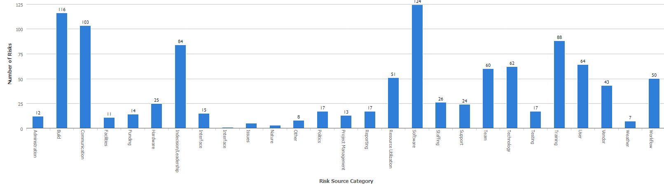
Risk Register Data

Slide 47
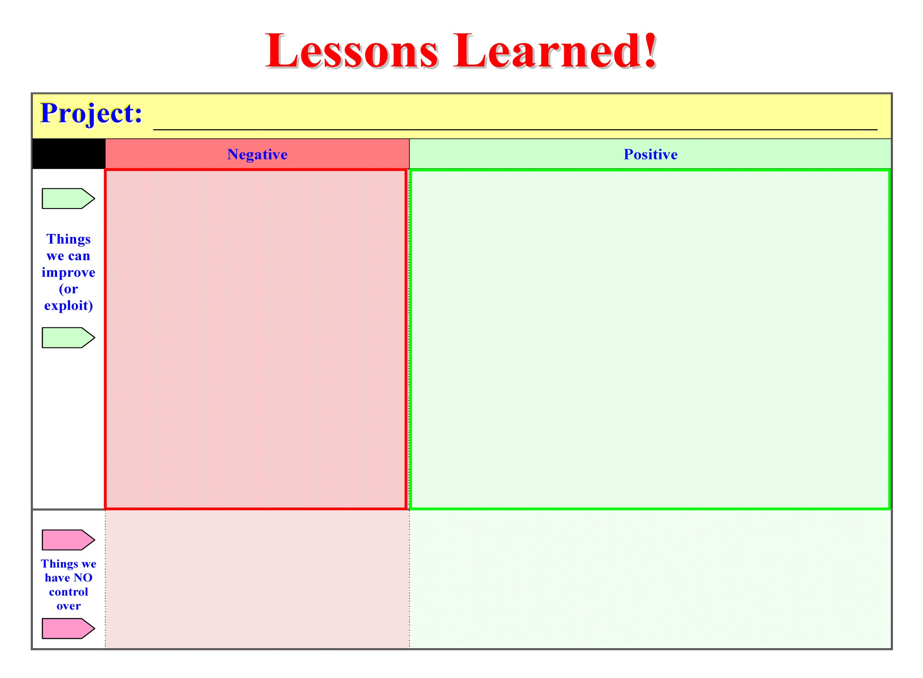
Lessons Learned Tool

Slide 48
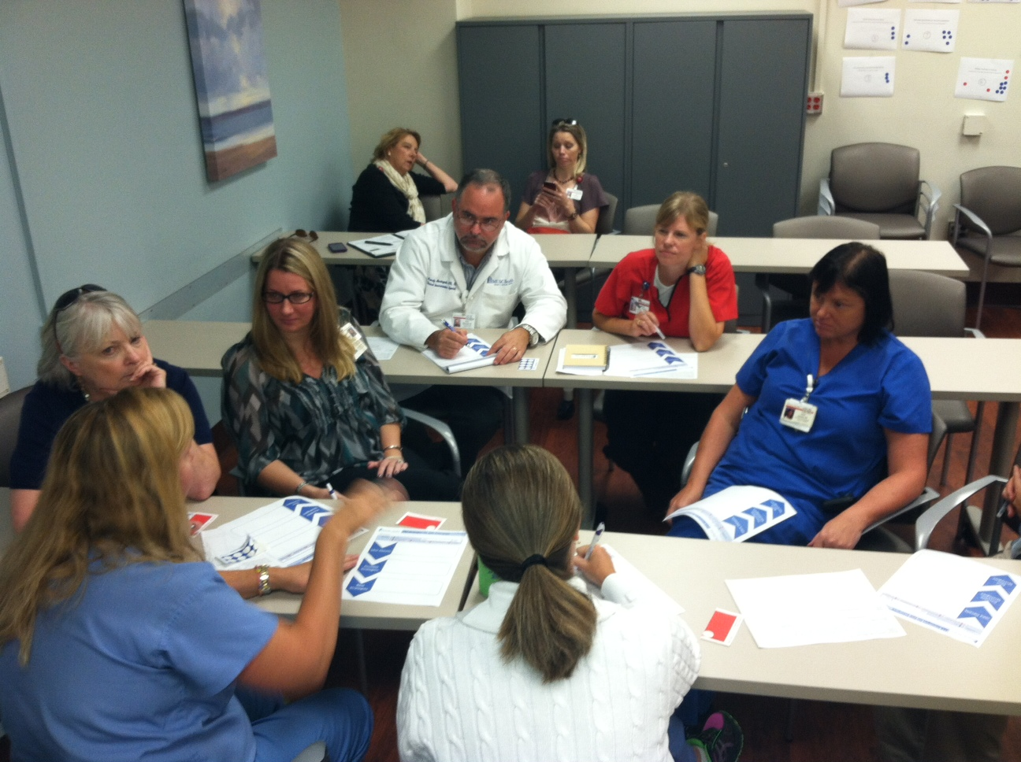
Create tools to help teams work toward solutions

Slide 49
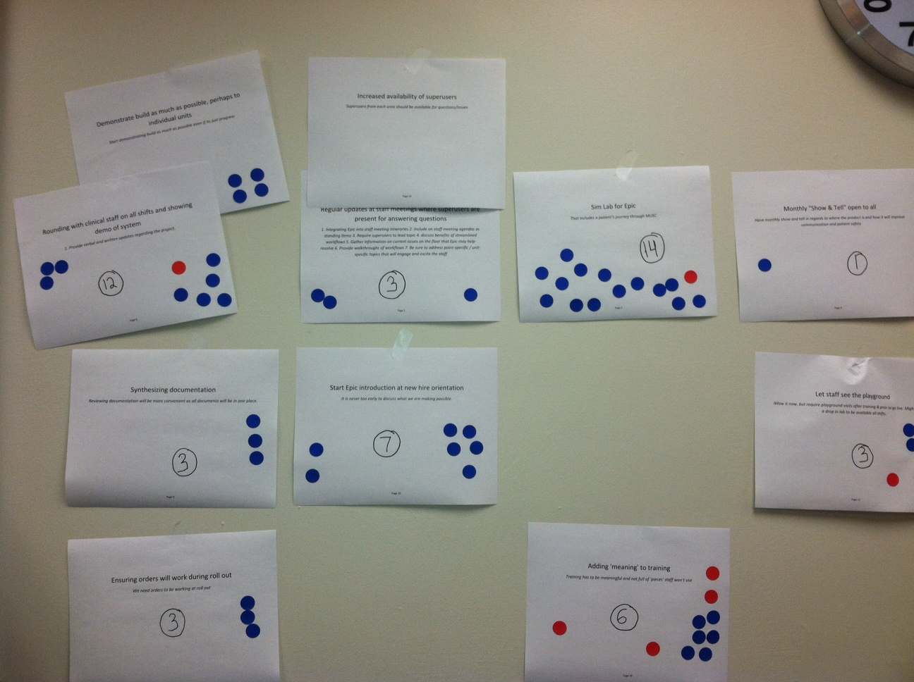
Use Multi-voting to avoid authority bias

Slide 50
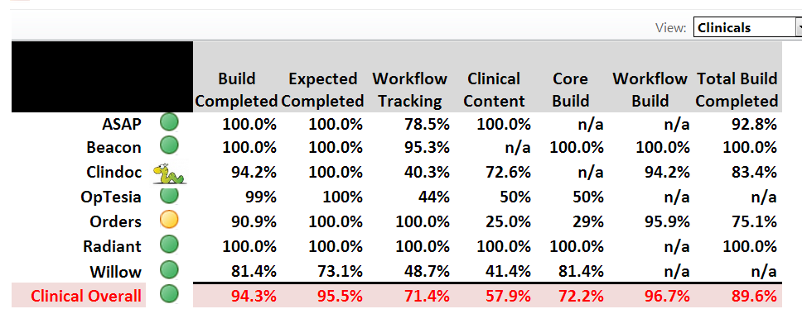
Project
Dashboard

Slide 51
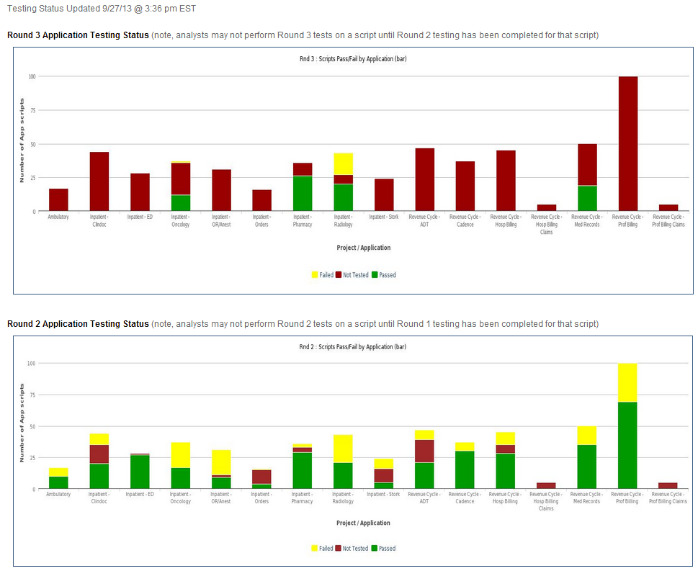
Project
Testing Dashboard

Slide 52
Growing Your Knowledge
Join & participate in your local PMI chapter!
Join the PMI Healthcare Community of Practice!
Read Kathy’s & Dan’s book (it is a great desktop reference, introduction to healthcare PM guide, and/or student text)!
Join your local HIMSS chapter & network!
Volunteer to work on healthcare projects in local hospitals or practice plans!
Enroll in a Masters in Health Administration, statewide hospital or practice plan association program, or other program that teaches healthcare project management!

Slide 53
Conclusions
The healthcare industry in general is behind most other industries in terms of project, program, and portfolio management.
There’s a huge need to educate people in managing the many healthcare-related projects.
We can improve healthcare in this country – one project at a time!

Slide 54
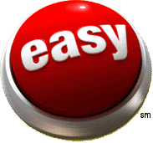
!
There is no “Easy Button”!
678

Slide 55
Questions?
Dan Furlong & Kathy Schwalbe
13 Dec 2013
Visit www.healthcarepm.com
furlongd@musc.edu
schwalbe@augsburg.edu
Notes:
This presentation is intended for the starting segment: project management practitioners who don’t know much about PMI, and/or beginners, students, and others considering a career or specialization in project management. PMI members already know (or should know!) most of what’s in it. It provides a basic look at what PMI is, what it does, and why membership and PMI credentials are smart moves for practitioners. It should take about 20 minutes at a conversational pace.
Component leaders who are addressing organizations – businesses, government bodies, or non-profits -- should use “The Value of Project Management,” which concentrates on organizational rather than personal benefits.
Obviously every audience is different, and there’s a lot of information that won’t fit into the slides and speaker notes. Learn as much as you can about the audience in advance and use your judgment: feel free to delete a slide, skip past it quickly – or to expand on the speaker notes if there’s a topic of special interest to this group.
Some slides have action buttons in the top right corner. If you’re online during the presentation, and want to dig a little deeper, those buttons will open the relevant page at the PMI website. The corresponding URLs are found in the speaker notes (and are also live links when you’re using PowerPoint’s “notes page” view).
LAST UPDATED February 2009

