Slide 1



Teaching Project Management to Healthcare Professionals:
A Much Needed Skill!
Kathy Schwalbe
September 18, 2013

Slide 2


About the Presenter
Ph.D., PMP, and mother of 3!
Professor, author, and publisher
Beyonce copied my new do?!
www.kathyschwalbe.com

Slide 3
Questions About You
Do you currently teach project management?
Do you currently work on projects related to healthcare?
Do you plan to work on or teach about healthcare projects?
Do you want good resources to help you teach or apply good project management in a healthcare environment?

Slide 4
Webinar Objectives
Describe the growing need for improving healthcare project management (PM)
Discuss similarities and differences in managing projects in healthcare
Explain sample outputs applied to a healthcare project
Review teaching approaches and available resources
Notes:
Recommendations
To optimize success, look for ways to limit the size, complexity and duration of individual projects, and ensure funding has been committed.
Stay on top of costs, especially for the largest projects. Ensure that there are the appropriate mechanisms in place to identify budget variances and/or overruns early. Regularly review how cost estimation is done to understand how accurate and effective your approaches are, and pursue improvement opportunities.
Keep the schedule realistic. Many large projects fail because business conditions keep changing after the project scope has been set, leaving a significant disconnect between the agreed-on scope and budget versus what the business will require and pay for by the time the project is delivered.
Invest in truly capturing and understanding the business expectations and functionality sought from the project, and ensure that there is initial, adequate allocated funding, as well as good processes in place for revisiting the expectations and required funding at multiple points during the project.
Increase the frequency of project status and review meetings, as well as ongoing confirmation of the project’s alignment with business strategy — with an eye toward identifying and cancelling projects at the earliest possible stage that no longer meet company needs.

Slide 5
The Need*
Healthcare spending was 17.9% of U.S. GDP in 2010, an average of $8,402 per person
The Centers for Medicare and Medicaid Services (CMS) estimates that healthcare spending will grow to about 19.8% of GDP by 2020
Compared to other Organisation for Economic Co-operation and Development countries, the U.S. spends 48% more on healthcare compared to the next highest country, Switzerland
*The Henry J. Kaiser Family Foundation. Healthcare Costs: A Primer, Key
Information on Healthcare Costs and Their Impact. 2012.

Slide 6
The Triple Aim*
Improving the U.S. healthcare system requires simultaneous pursuit of three aims:
Improving the experience of care
Improving the health of populations
Reducing per capita costs of health care
*Donald M. Berwick, Thomas W. Nolan, Whittington J. The Triple Aim:
Care, Health, And Cost. HealthAffairs. 2008;27(3):759-69.

Slide 7
Patient Protection and Affordable Care Act (PPACA or ACA)
This March 2010 Act resulted in incentives and enablers for the implementation of Electronic Medical Records (EMR), associated meaningful use, resultant procedural changes, and health information exchanges
All of these initiatives coupled with movements to patient-centered care, evidence-based medicine, centers of excellence, and other forces have spawned a current climate of what may be an unsurpassed number of healthcare projects

Slide 8
Education Can Help
Public health and healthcare leaders need to:
  Work on the right projects
  Get the most bang from every buck
  Make investments in IT, infrastructure, and quality improvements that will allow them to reduce costs
Good project management and educating PMs can definitely help!

Slide 9
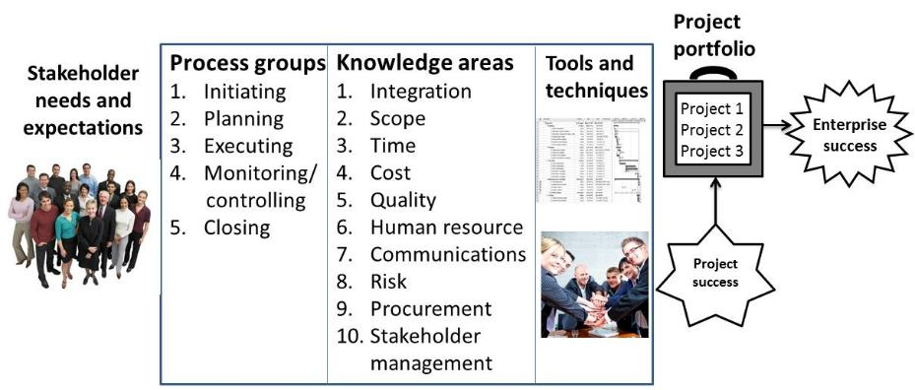
Project Management Framework-Same for All Projects*
*Kathy Schwalbe, An Introduction to Project Management, 2012 and Healthcare Project Management, 2013 (co-authored with Dan Furlong).

Slide 10
Process Groups Matching Game
Key Term | Definition or Characteristic
1. Initiating | A. Purpose is to guide execution
2. Planning | B. A project charter is created
3. Executing | C. Usually takes the most time and money
4. Monitoring and Controlling | D. Lessons learned and transition plans are created
5. Closing | E. Measure progress toward achieving project goals
Hint: The order of the correct answers spells a word, but incorrectly!

Slide 11
Similarities in Healthcare Projects
Projects still include all 10 knowledge areas and 5 process groups
Projects have the same attributes and constraints
The same tools and techniques apply
Consumers keep expecting more for less

Slide 12
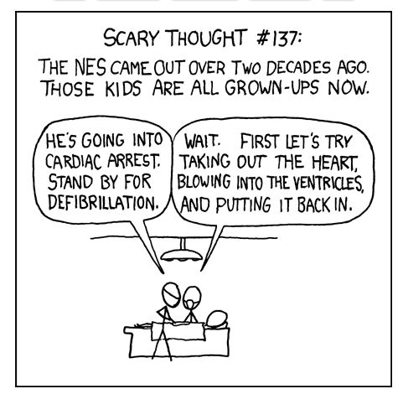
Source: xkcd.com

Slide 13
What’s Different About Healthcare Project Management?
There are two “camps” of people: clinical/philanthropic vs. enterprise marketplace viability and sustainability folks
Healthcare has a lot of unique terms/processes
Projects often have separate phases – technical and clinical
Project management is not as mature/practiced in healthcare
Many projects affect workflow, and patient care must take priority

Slide 14
Findings from Recent Study*
Healthcare workers do not understand the differences between service work and project work. They understand activities to provide better service to patients, but they have not been trained to make more radical, disruptive changes that challenge the status quo.
Healthcare projects are done to create something that is delivered to the organization, unlike operational work which produces outcomes aimed at patients. “In other words, it is only once the project’s outcome is implemented and becomes ‘the new way we work now’ that it starts exerting its impact on patients.”
*Francois Chiocchio et al, “Stress and Performance in Health Care Project Teams,” Project Management Institute (2012).

Slide 15
Suggestions from Recent Study
Train healthcare workers on PM, emphasizing collaborating on achieving project goals and understanding their roles on project teams, which may differ from their roles in their day-to-day work.
Management needs to structure project teams by properly planning workers’ time and payment to allow them to successfully engage in project work.

Slide 16
Healthcare PM Table of Contents
Chapter 1 | An Introduction to Project, Program, and Portfolio Management in Healthcare
Chapter 2 | Project, Program, and Portfolio Selection
Chapter 3 | Initiating Projects
Chapter 4 | Planning Projects, Part 1 (Project Integration and Scope Management)
Chapter 5 | Planning Projects, Part 2 (Project Time and Cost Management)
Chapter 6 | Planning Projects, Part 3 (Project Quality, Human Resource, Communications, Stakeholder, Risk, and Procurement Management)
Chapter 7 | Executing Projects
Chapter 8 | Monitoring and Controlling Projects
Chapter 9 | Closing Projects
Chapter 10 | Best Practices in Project Management
Appendix A | Brief Guide to Microsoft Project 2013
Appendix B | Resources

Slide 17

Approach
Opening case
Explain key concepts
Provide real-world examples with references of what went right, what went wrong, best practices, media snapshots, healthcare perspectives, and video highlights
Apply concepts with samples from running case on Ventilator Associated Pneumonia Reduction (VAPR)
Closing case

Slide 18
Sample Outputs in New Book
  Initiating: business case, stakeholder analysis, charter
  Planning: project management plan, scope statement, requirements traceability matrix, WBS, project schedule, cost baseline, quality metrics, human resource plan, project dashboard, probability/impact matrix, risk register, supplier evaluation matrix, stakeholder management plan
  Executing: deliverables, milestone report, change requests, project communications, issue logs
  Monitoring and controlling: earned value chart, accepted deliverables, quality control charts, performance reports
  Closing: project completion form, final report, transition plan, lessons-learned report, contract closure notice

Slide 19
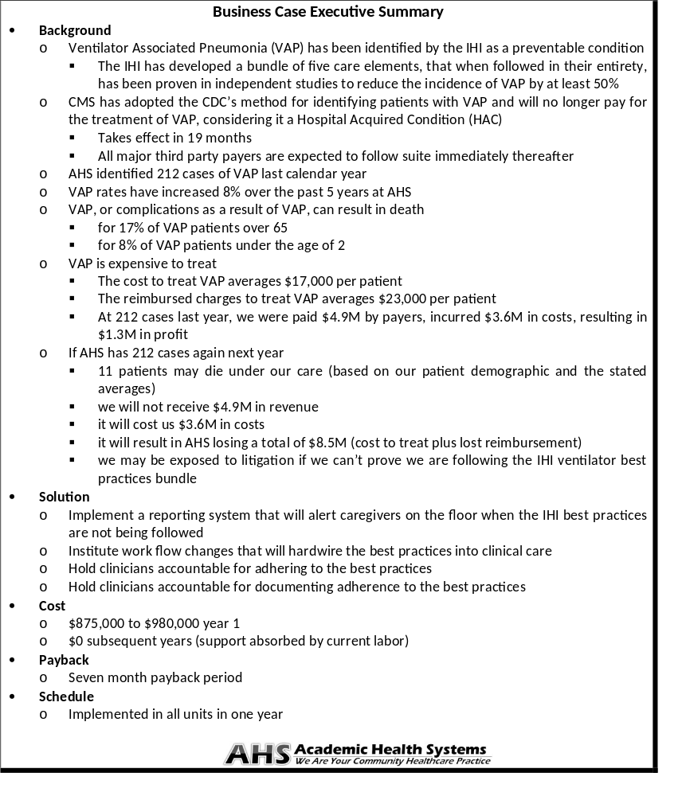
Business
Case
Copyright 2013 Schwalbe Publishing

Slide 20
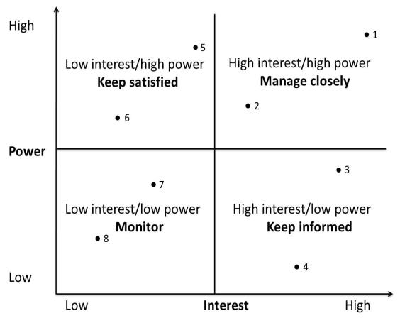
Stakeholder Analysis Power/Interest Grid
Copyright 2013 Schwalbe Publishing

Slide 21
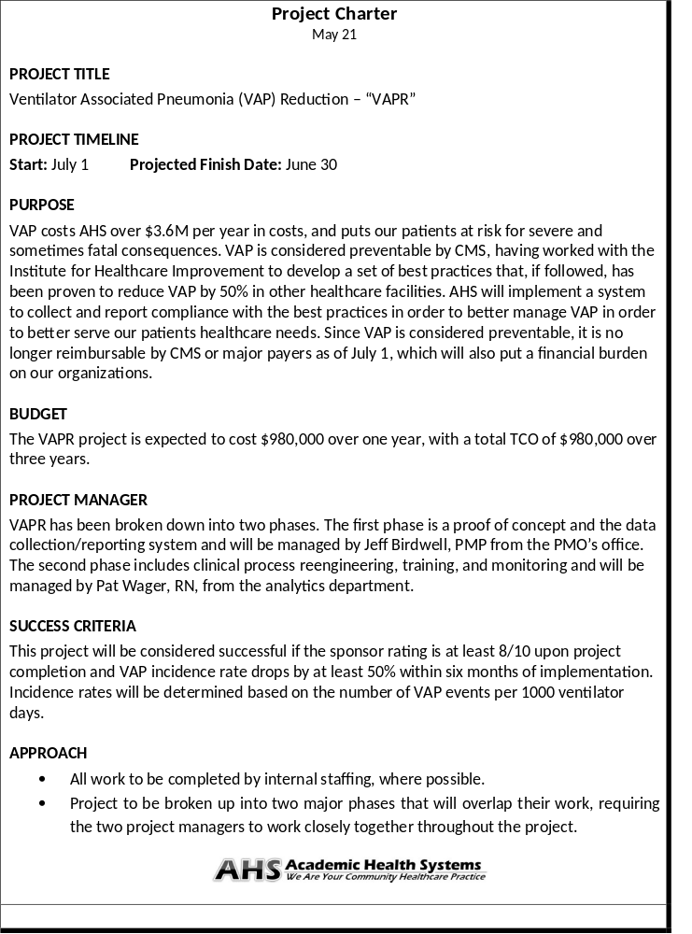
Project
Charter
Copyright 2013 Schwalbe Publishing

Slide 22
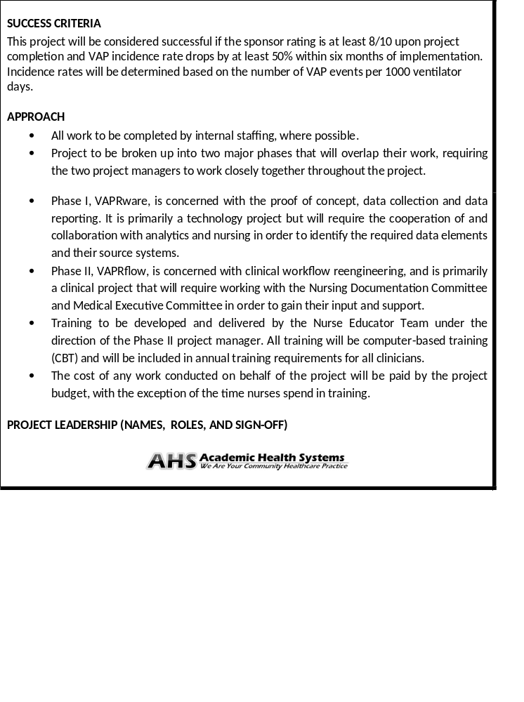
Project
Charter
Copyright 2013 Schwalbe Publishing

Slide 23
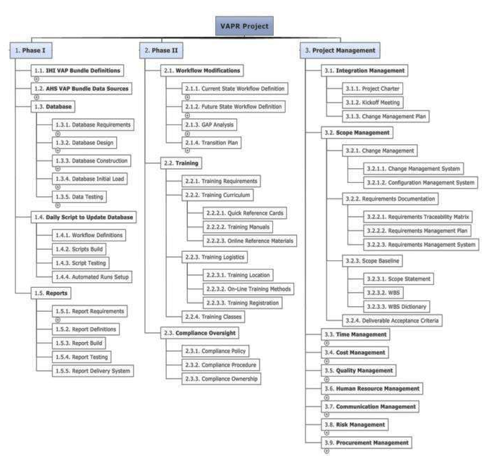
Work Breakdown Structure
Project scope/ deliverables
Copyright 2013 Schwalbe Publishing

Slide 24
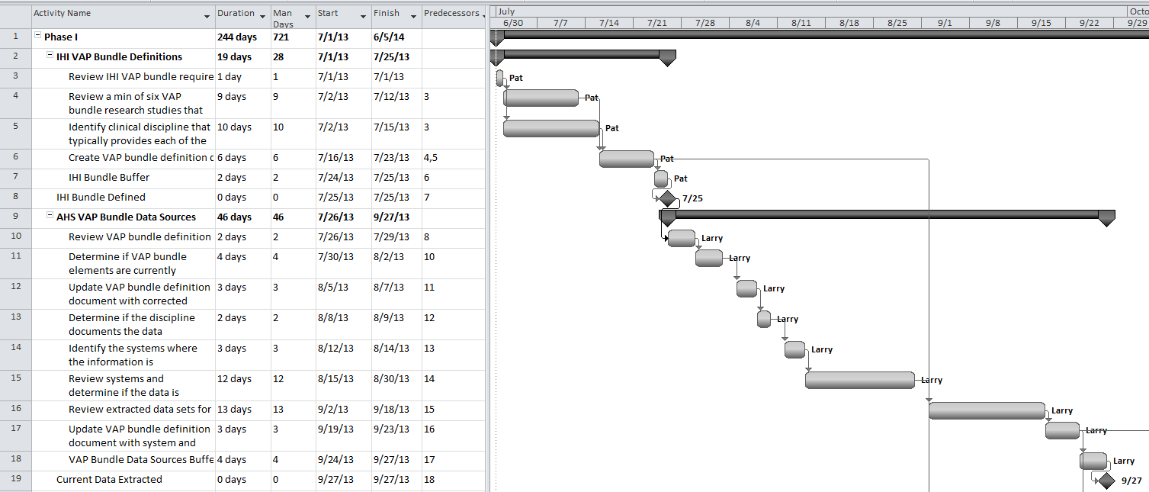
Gantt Chart
Project schedule
Copyright 2013 Schwalbe Publishing

Slide 25
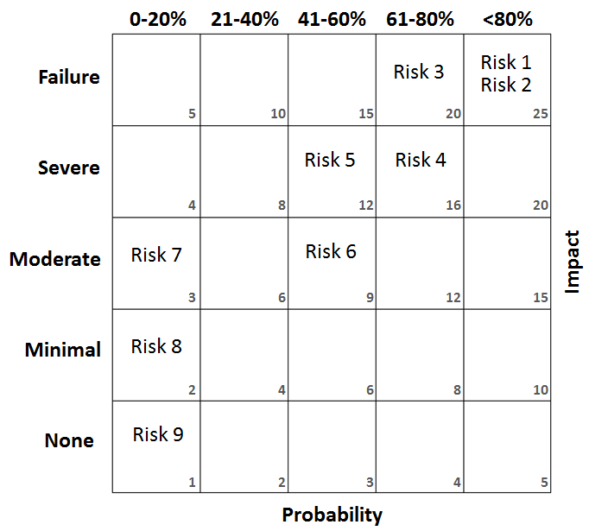
Probability Impact Matrix
Must identify risks to manage them
Copyright 2013 Schwalbe Publishing

Slide 26
Project Dashboard
Metric | Description | Status | How Measured | Explanation
Scope | Meeting project goals | ● | Earned value chart | On target
Time | Staying on schedule | ● | Earned value chart | Slightly behind schedule
Cost | Staying on budget | ● | Earned value chart | Under budget
VAP Bundle | Identify AHS systems with required elements | ● | Percent of elements identified in AHS systems | All elements identified and available
VAP reduction | Reduce by 50% within six months | ↔ | Infection Control data | Cannot collect until after implementation
Percent of ICU staff trained | Train all ICU staff prior to go live | ● | Training Management System test results | Learning management system down for four days causing a delay in training. We expect to catch up quickly.
Track
metrics
Copyright 2013 Schwalbe Publishing
● On Target | ● Off Target / problem area
● Slightly off target / caution area | ↔ Not able to collect data yet

Slide 27

Cause and Effect Diagram
Find root
cause
Copyright 2013 Schwalbe Publishing

Slide 28
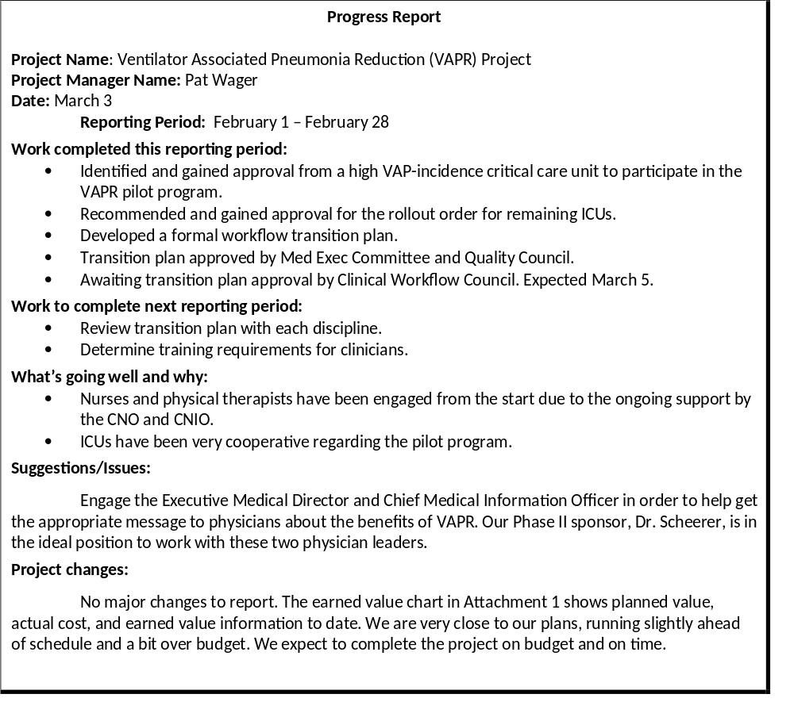
Progress Report
Super tool everyone should use!
Copyright 2013 Schwalbe Publishing

Slide 29
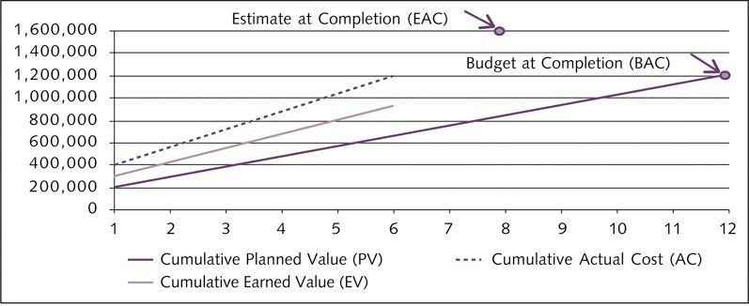
Earned Value Chart
Assess progress in meeting scope, time, and cost goals
Copyright 2013 Schwalbe Publishing

Slide 30
Best Practice- Earned Value Management
The Centers for Medicare & Medicaid Services (CMS) manages approximately twenty percent of the entire Federal budget, so it is important that they use the taxpayers' dollars as efficiently and effectively as possible.
“Once an investment—with its individual projects—is approved for funding, it falls to the investment manager and the project managers to insure that the projects are implemented successfully. Earned value monitoring and management provides early warning when a project is straying from its baseline plan, and shows whether actions taken to correct the situation are effective. Health and Human Services (HHS) requires that certain investments track and report on cost and schedule status monthly.”*
*CMS Centers for Medicare & Medicaid Services, Division of Information Technology Investment Management Enterprise Architecture & Strategy Group Office of Information Services, “Earned Value Management Best Practices” (Nov 19, 2009).

Slide 31
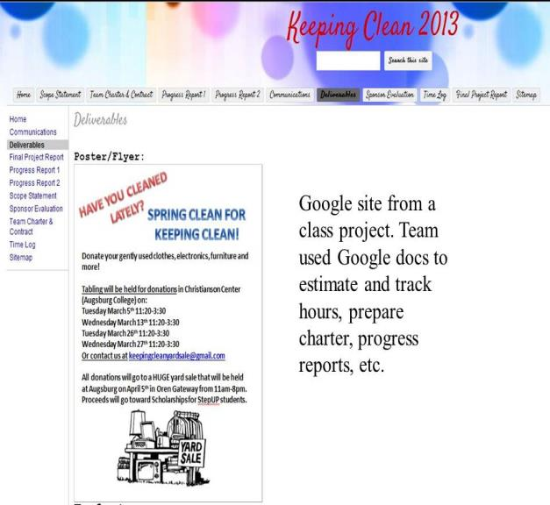
Team Project Web Sites
Great communications tool
Copyright 2013 Schwalbe Publishing

Slide 32
Teaching Approaches
Type of Training/Course
Traditional
Hybrid
Workgroup
Team
Pair
Flip Course
Presentation
Presence
Full Course, undergrad/grad
Compressed Course
Seminar
Individual
Project Assignment and Assessment
Real or Textbook Case
Papers/Exams
Simulation

Slide 33





Challenges and Nuances
GOAL
Healthcare
Quality, real effect
Time
Group, you, client, breaks, graduation
Access to projects
Privacy, complexity, timeframe, prior knowledge
Little basis in topic
Business, project management, healthcare, basic software
Notes:
Revise content. May want to change

Slide 34
Resources
FREE companion Web site for Healthcare Project Management includes
  Over 60 template files
  Links to great videos
  Interactive quizzes, cases, PMP info, etc.
Secure instructor site also available. Instructors should email me for access (and review/desk copies)
  www.healthcarepm.com

Slide 35
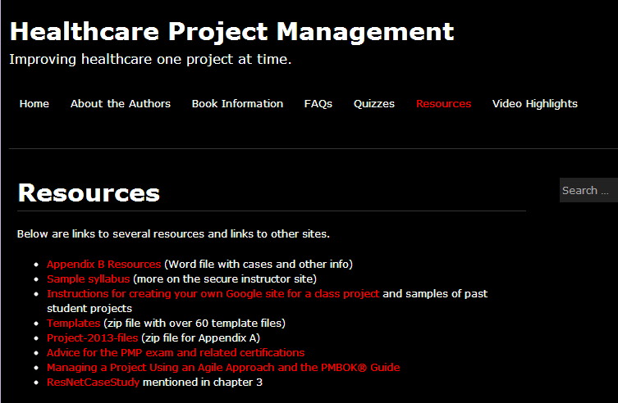
Screen Shot of Resources

Slide 36
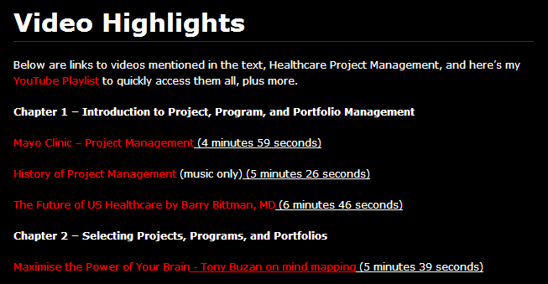
Screen Shot of Video Highlights

Slide 37
Rooting Out Waste in Health Care by Taking Cue From Toyota (Video)
When the Virginia Mason Medical Center in Seattle was losing money for the first time in its history, CEO Dr. Gary Kaplan, MD, turned to Toyota to learn how to root out waste.
For example, they are trying to totally eliminate waiting rooms. If there are a lot of people in a waiting room, you know that the workflow is inefficient. They now has workflow managers who help minimize waste, including the waste of patients’ time.
Some of the tangible benefits of reducing waste include a reduction in liability costs by 60% since 2004 and improved patient care. Also, the amount of time nurses spend in direct contact with patients has increased from only 35% to 90%.

Slide 38
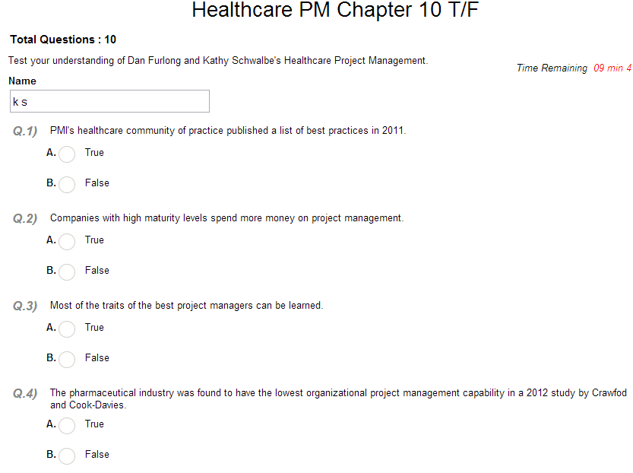
Sample Quiz

Slide 39
Conclusions
The healthcare industry in general is behind most other industries in terms of project, program, and portfolio management.
There’s a huge need to educate people in managing the many healthcare-related projects.
We can improve healthcare in this country – one student, one course, and one project at a time!

Slide 40
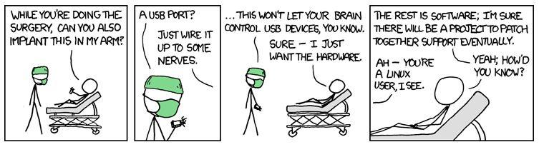
Too bad we can’t implant software to make us all smarter – yet!
Source: xkcd.com

Slide 41

Questions/Comments?
www.healthcarepm.com
www.intropm.com
schwalbe@augsburg.edu

